Slide 1
International Study of Comparative Health Effectiveness with Medical and Invasive Approaches ‒ Chronic Kidney Disease Primary Report of Quality of Life Outcomes
Funded by National Heart, Lung, and Blood Institute
John A. Spertus, MD, MPH
Saint Luke’s Mid America Heart Institute/UMKC
On behalf of the ISCHEMIA-CKD Research Group

Slide 2
ISCHEMIA-CKD QoL Research Question
In a stable patient with advanced CKD and at least moderate ischemia, does an invasive strategy improve patients’ health status (symptoms, function and quality of life)?

Slide 3
Study Design
Stable Patient
Moderate or severe ischemia
(determined by site; read by core lab)
INVASIVE Strategy + OMT
…
R
1.5m
3m
6m
12m
18m
24m
30m
36m
CONSERVATIVE OMT alone (Cath if needed)
Brief QoL Assessments
Brief QoL Assessment
Brief QoL Assessment:
Seattle Angina Questionnaire – 7
Angina Frequency**
Quality of Life**
Physical Limitations
Completion Rates
Con: 92%
Inv: 88%
90%
85%
91%
90%
89%
85%
90%
87%
87%
86%
85%
82%
88%
80%
SAQ Summary Score*
*Primary QoL Outcome
**Secondary QoL Outcome

Slide 4
Statistical Methods
Simple descriptive statistics of observed mean scores
Mixed-effect proportional odds models for all QOL scales
Treatment effect = Odds ratio for QOL ≥ X, at each time point
Results transformed to individual SAQ scales
Bayesian methods used for all models to directly estimate probability of treatment effect with posterior means and 95% posterior density intervals
Joint models to account for drop-outs due to death as a secondary analysis
Analyses performed for all patients and stratified by baseline angina
e.g. daily/weekly vs. several times per month vs. no angina

Slide 5
Patient Flow
777 Randomized
389 Conservative
388 Invasive
21 improper form completion
21 improper form completion
368 Eligible for
QOL Analyses
367 Eligible for
QOL Analyses
1 no baseline assessment
9 no follow-up assessments
8 no baseline assessments
12 no follow-up assessments
358 Included in Analyses of
Treatment Effect
347 Included in Analyses of Treatment Effect

Slide 6
Baseline Health Status
Scale | Invasive | Conservative
SAQ Summary Score | 75.7$±$20 | 76.0$±$19
SAQ Quality of Life Score | 65.3$±$28 | 66.2$±$27
SAQ Angina Frequency Score | 86.7$±$18 | 86.9$±$18
Daily/Weekly Angina | 11.9% | 11.7%
Several Times per Month | 38.2% | 40.2%
No Angina | 50.0% | 48.0%

Slide 7
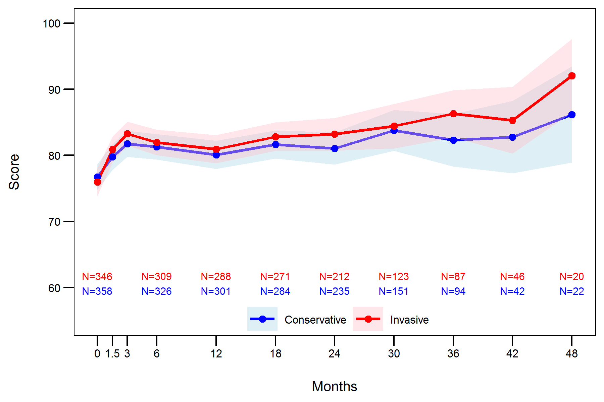
Description of Observed Data – All Patients
SAQ Summary Score

Slide 8
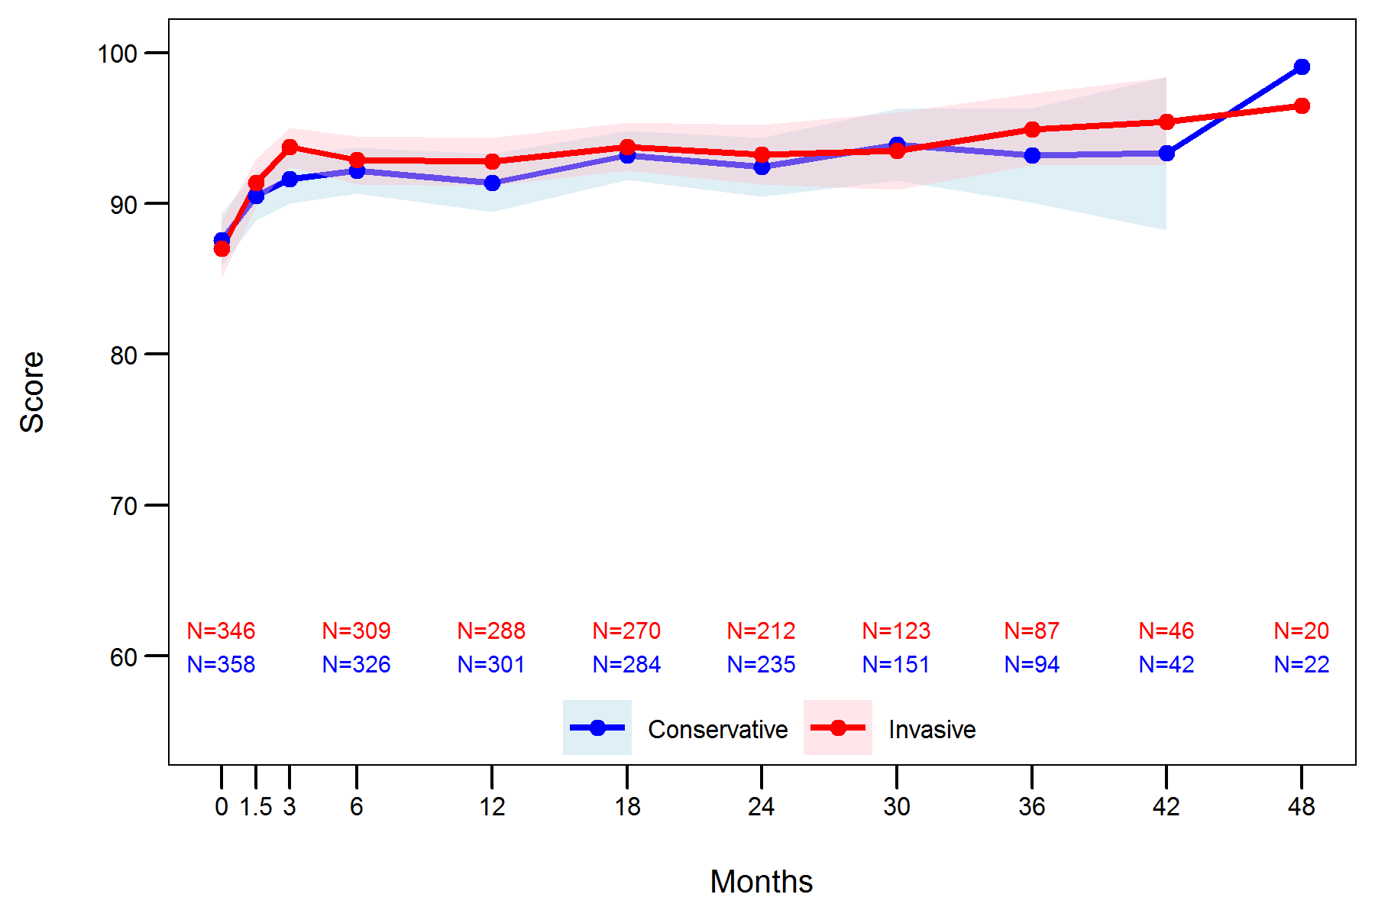
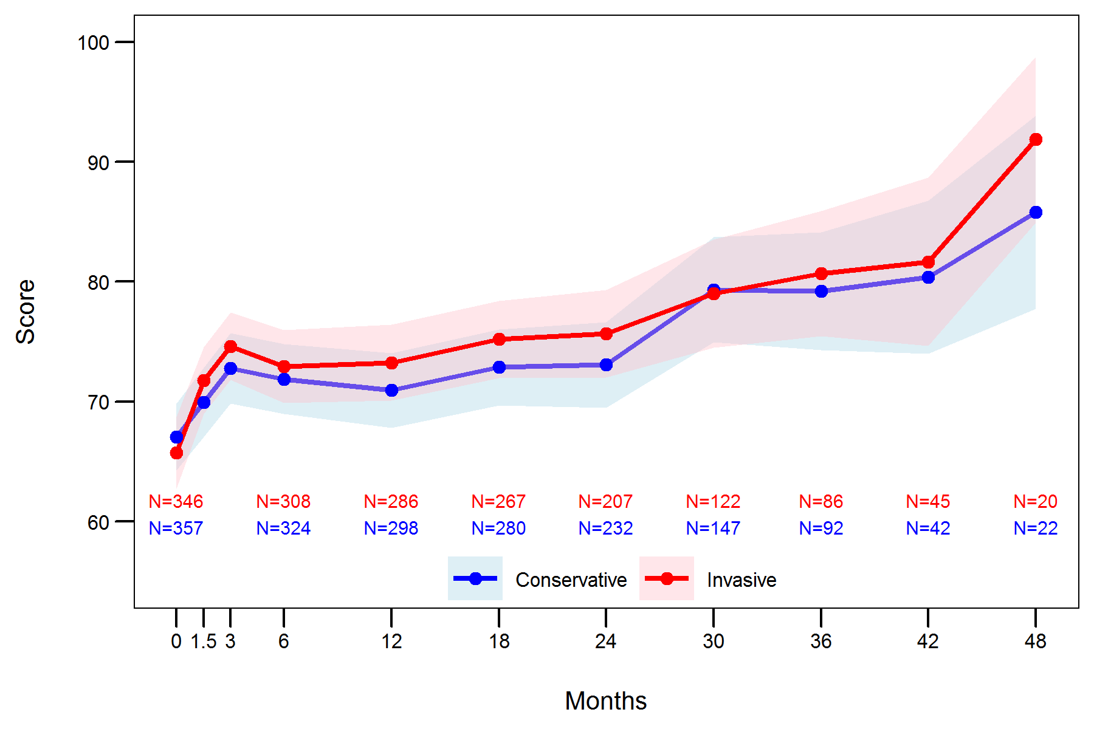
Description of Observed Data – All Patients
SAQ Angina Frequency Score
SAQ Quality of Life Score

Slide 9
Probability Distribution of Treatment Benefit from Bayesian Analyses
All Patients
Posterior Mean = 2.1 (-0.4, 4.6)*
N=651
Posterior Mean = 0.1 (-3.0, 3.1)*
N=589
Posterior Mean = 0.5 (-3.6, 4.5)*
N=181
Favors Conservative
Favors Invasive
Favors Conservative
Favors Invasive
Favors Conservative
Favors Invasive
*95% Highest Posterior Density Interval

Slide 10
Probability Distribution of Treatment Benefit on SAQ Summary Score
Daily/Weekly Angina
Posterior Mean = 10.1 (0.0, 19.9)*
N=74
Posterior Mean = 2.2 (-8.0, 13.1)*
N=69
Posterior Mean = 0.7 (-13.8, 16.2)*
N=21
Favors Conservative
Favors Invasive
Favors Conservative
Favors Invasive
Favors Conservative
Favors Invasive
*95% Highest Posterior Density Interval

Slide 11
Probability Distribution of Treatment Benefit on SAQ Summary Score
At Least Monthly Angina
Posterior Mean = 2.2 (-2.0, 6.2)*
N=255
Posterior Mean = 1.0 (-4.0, 6.2)*
N=232
Posterior Mean = 1.5 (-5.1, 8.2)*
N=64
Favors Conservative
Favors Invasive
Favors Conservative
Favors Invasive
Favors Conservative
Favors Invasive
*95% Highest Posterior Density Interval

Slide 12
Probability Distribution of Treatment Benefit on SAQ Summary Score
No Angina
Posterior Mean = 0.6 (-1.9, 3.3)*
Posterior Mean = -0.8 (-4.2, 2.8)*
N=287
Posterior Mean = 0.0 (-4.2, 4.3)*
N=96
N=321
Favors Conservative
Favors Invasive
Favors Conservative
Favors Invasive
Favors Conservative
Favors Invasive
*95% Highest Posterior Density Interval

Slide 13
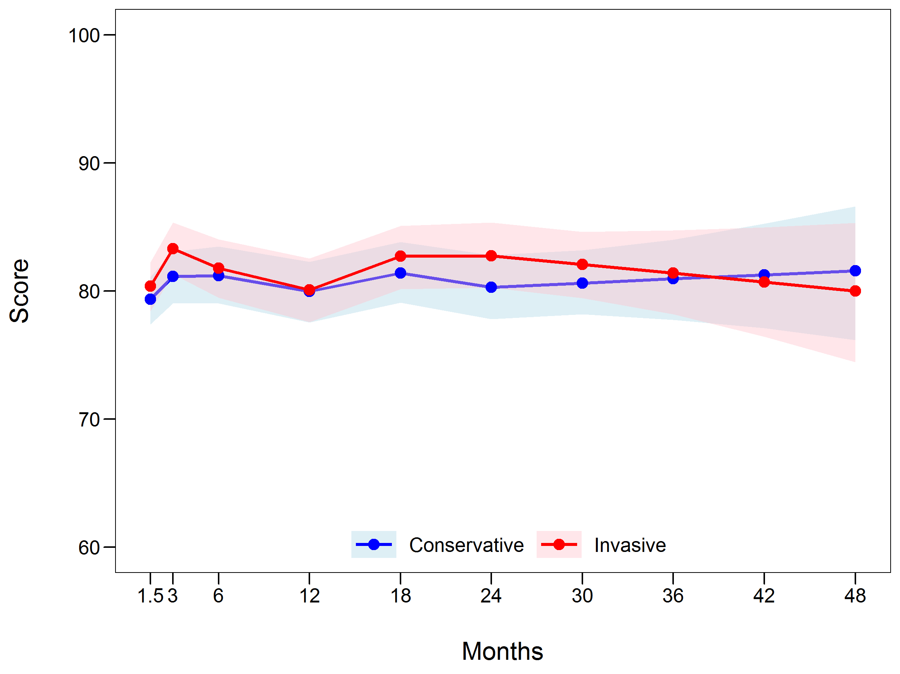
Predicted Means of SAQ SS with Joint Models

Slide 14
SAQ-7 Summary Score Odds Ratios
Month | Odds Ratios (95% CrIs) | Probability (%) of Any Benefit
1.5 | 1.20 (0.76, 1.66) | 81%
3 | 1.48 (0.90, 2.16) | 95%
6 | 1.13 (0.61, 1.69) | 65%
12 | 1.06 (0.55, 1.62) | 53%
24 | 1.59 (0.77, 2.49) | 93%
36 | 1.16 (0.45, 2.03) | 59%

Slide 15
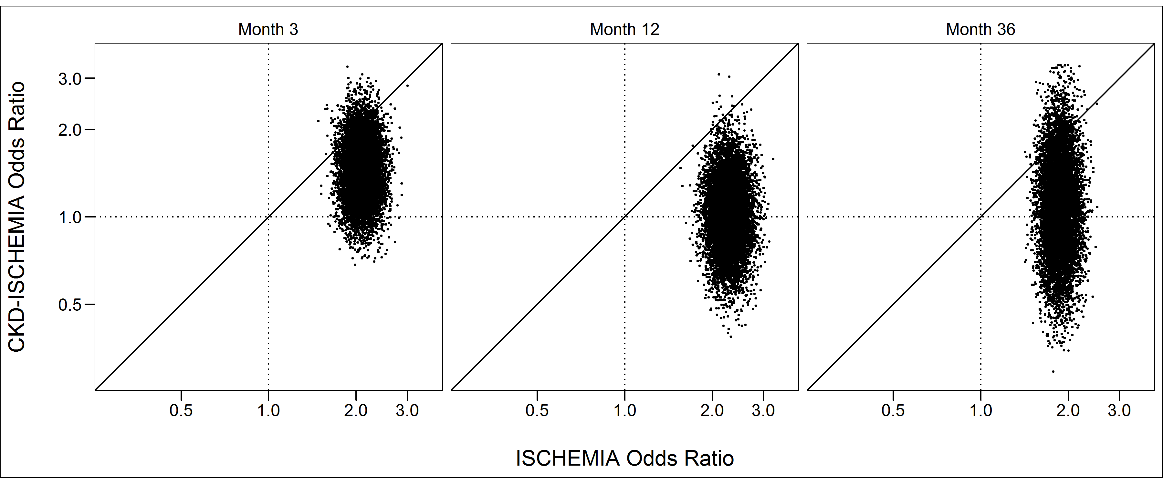
Posterior Distribution of ORs for Main and CKD Trials
94 % Probability
CKD OR < Main OR
99% Probability
CKD OR < Main OR
93% Probability
CKD OR < Main OR

Slide 16
Limitations
Missing SAQ data, although small (<15%)
Very skewed enrollment towards less symptomatic patients; may not have been able to discern a QoL benefit in more symptomatic patients
Large mortality rate, but little difference in joint models due to similar mortality in both arms

Slide 17
Conclusions
In patients with stable CAD, advanced CKD and moderate to severe ischemia, we did not observe a substantial improvement in angina control and quality of life over time
However, given the large proportion of asymptomatic patients at baseline, we cannot exclude the possibility of a small benefit in symptomatic patients

Slide 18
Thank you….
Quality of Life Core Lab: Philip Jones, Dan Mark, Khaula Baloch, Lisa Hatch
ISCHEMIA-CKD PI: Sripal Bangalore
ISCHEMIA-CKD Analytic Center and DSMB: Sean O’Brien, Frank Harrell
ISCHEMIA-CKD Site PIs and Data Coordinators
ISCHEMIA Trial Chair & Co-Chair: Judith Hochman, David Maron
The Patients volunteering to participate in ISCHEMIA-CKD

Slide 19
Backup Slides

