Slide 1
International Study of Comparative Health Effectiveness with Medical and Invasive Approaches - Chronic Kidney Disease Primary Report of Clinical Outcomes
Funded by the National Heart, Lung, and Blood Institute
Sripal Bangalore, MD, MHA
NYU School of Medicine
On behalf of the ISCHEMIA-CKD Research Group

Slide 2
ISCHEMIA-CKD Research Question
In stable patients with advanced CKD and at least moderate ischemia on a stress test, is there a benefit to adding cardiac catheterization and, if feasible, revascularization to optimal medical therapy?

Slide 3

CKD Patients are Under-Represented in Contemporary Revascularization vs. Medicine SIHD Trials
2007
2009
2012
FAME 2 Trial
eGFR <30: 16 Subjects
Subjects with serum Cr >2 mg/dl excluded
Serum Cr >2 mg/dl: 20 subjects
Notes:
3

Slide 4

Study Design
Patients with moderate or severe ischemia and eGFR <30 or on dialysis
RANDOMIZE
1:1
INVASIVE Strategy
Optimal Medical Therapy + Cath +
Optimal Revascularization (if suitable)
CONSERVATIVE Strategy
Optimal Medical Therapy alone
Cath and revascularization (if suitable) reserved for Optimal Medical Therapy failure
Primary Endpoint: Composite of Death or MI
Bangalore et al. Am Heart J. 2018

Slide 5
Eligibility Criteria
Key Inclusion Criteria
At least moderate ischemia on an exercise or pharmacologic stress test (site determined)
End-stage renal disease on dialysis or estimated glomerular filtration rate (eGFR) <30mL/min/1.73m²
Key Exclusion Criteria
Left ventricular ejection fraction <35%
NYHA class III-IV heart failure
Unacceptable level of angina despite maximal medical therapy
ACS within the previous 2 months
PCI or CABG within the previous 12 months
Bangalore et al. Am Heart J. 2018

Slide 6
Optimizing Revascularization
Customized Hydration
Heart/Kidney Team
Ultra low/Zero Contrast PCI
LVEDP based (POSEIDON trial)
Cardiology/Nephrology/CV surgery

Slide 7
Endpoints
Primary Endpoint
Time to death or MI
Major Secondary Endpoints
Time to Death, MI, Hospitalization for Unstable Angina, Heart Failure or Resuscitated Cardiac Arrest
Quality of Life (separate presentation)
Safety Outcomes
Composite of initiation of maintenance dialysis or death
Initiation of maintenance dialysis

Slide 8
Statistical Considerations
Power Calculation (N = 777)
>80% power to detect 22% to 24% relative reduction in primary endpoint assuming an aggregate 4-year cumulative rate of approximately 41% to 48%
Pre-Specified Statistical Analysis
Intention-to-treat
Nonparametric cumulative event rates accounting for competing risks
Cox regression, covariate-adjusted
Emphasize nonparametric event rates if proportional hazards assumption is violated
Bayesian analysis
Evaluate the probability of possible hypotheses/conclusions in light of a set of minimally informative prior probabilities and the current study data

Slide 9
Patient Flow
Enrolled (802)
Randomized (777)
Invasive (388)
Conservative (389)
Median follow-up for survivors: 2.3y (1.9 to 3.2y)
Follow-up completed: 99.2%
Median follow-up for survivors: 2.5y (1.9 to 3.2y)
Follow-up completed: 99.7%

Slide 10
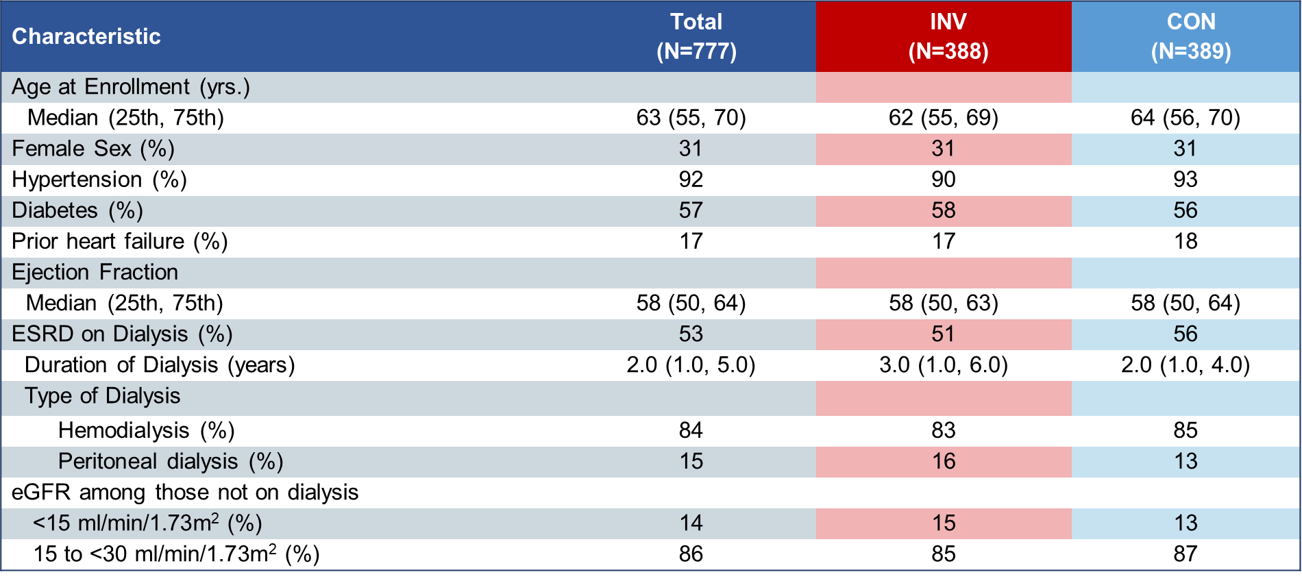
Key Baseline Characteristics

Slide 11
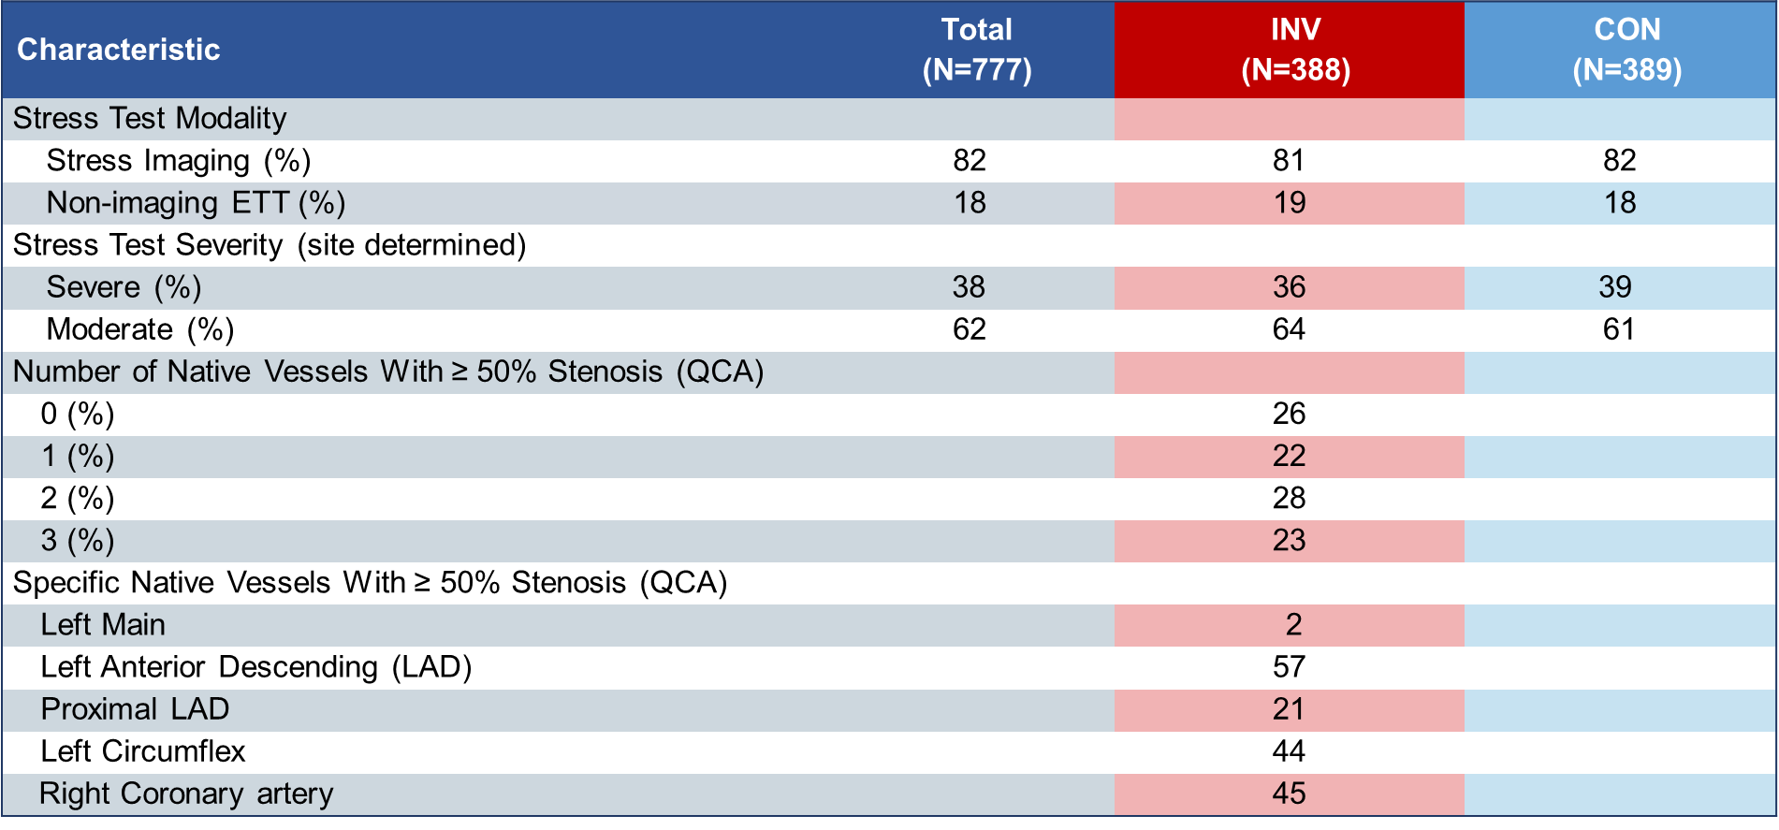
Key Stress Test and Angiographic Characteristics

Slide 12
Risk Factor Management No between group differences INV vs CON
High Level of Medical Therapy Optimization is defined as a participant meeting all of the following goals: LDL < 70 mg/dL and on any statin, systolic blood pressure < 140 mm/Hg, aspirin or other antiplatelet or anticoagulant and not smoking. High level of medical therapy optimization is missing if any of the individual goals are missing.

Slide 13
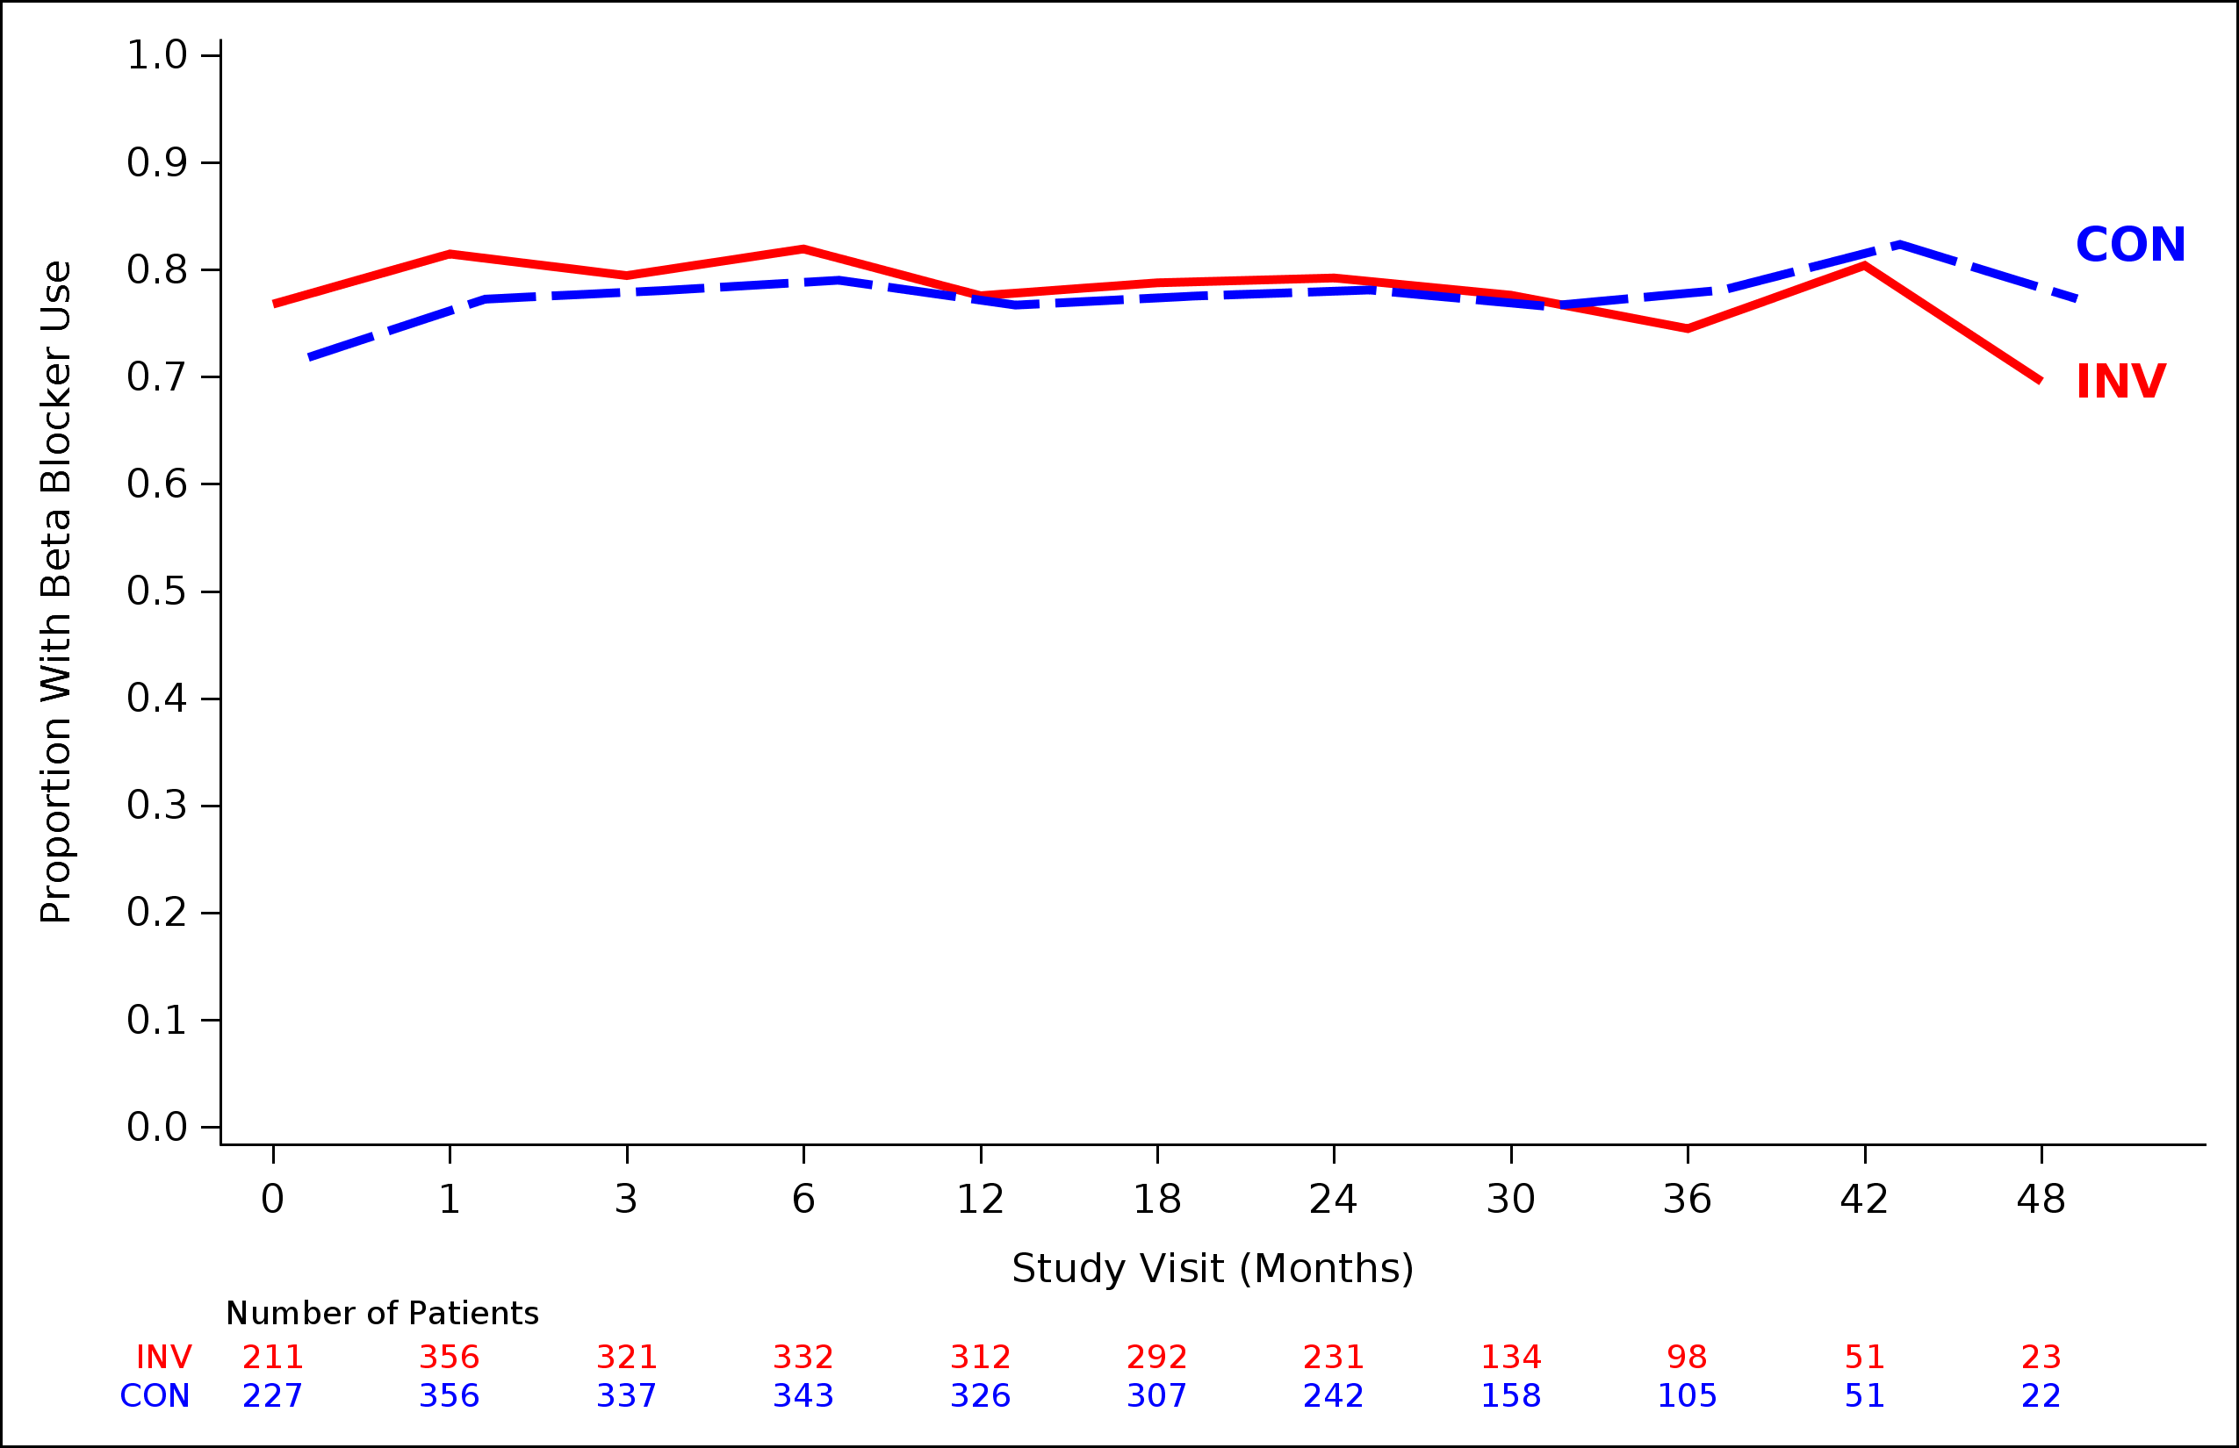
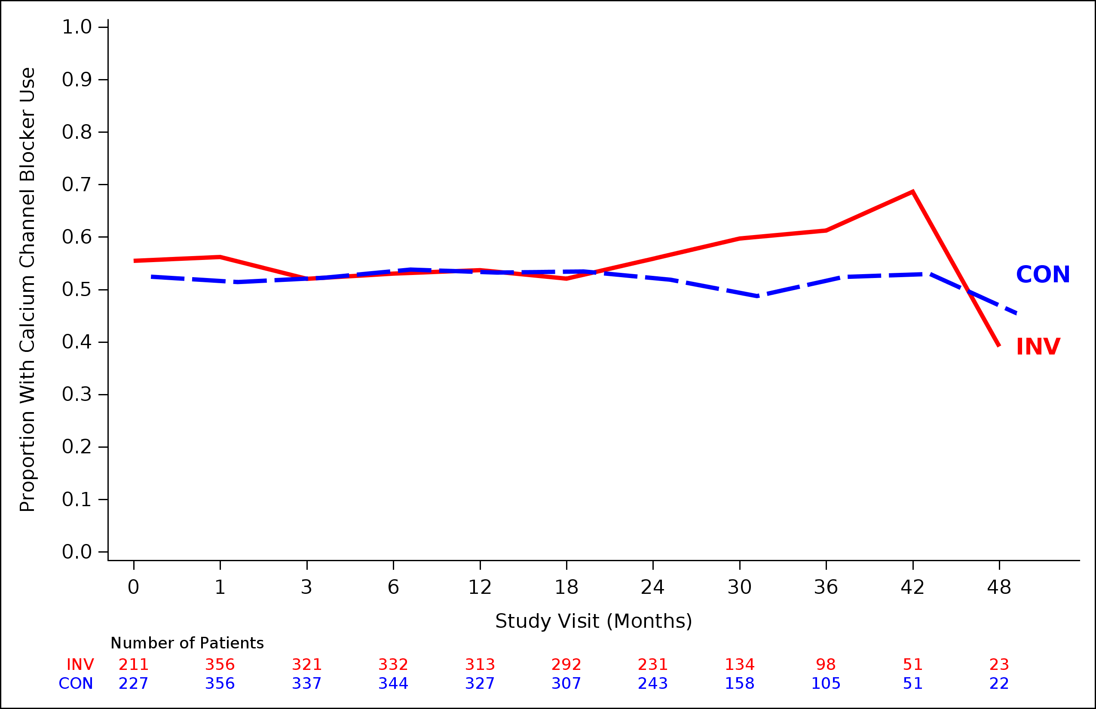
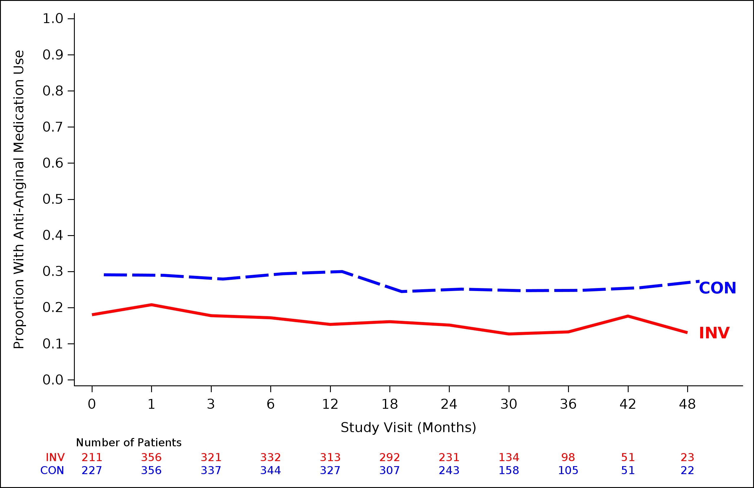
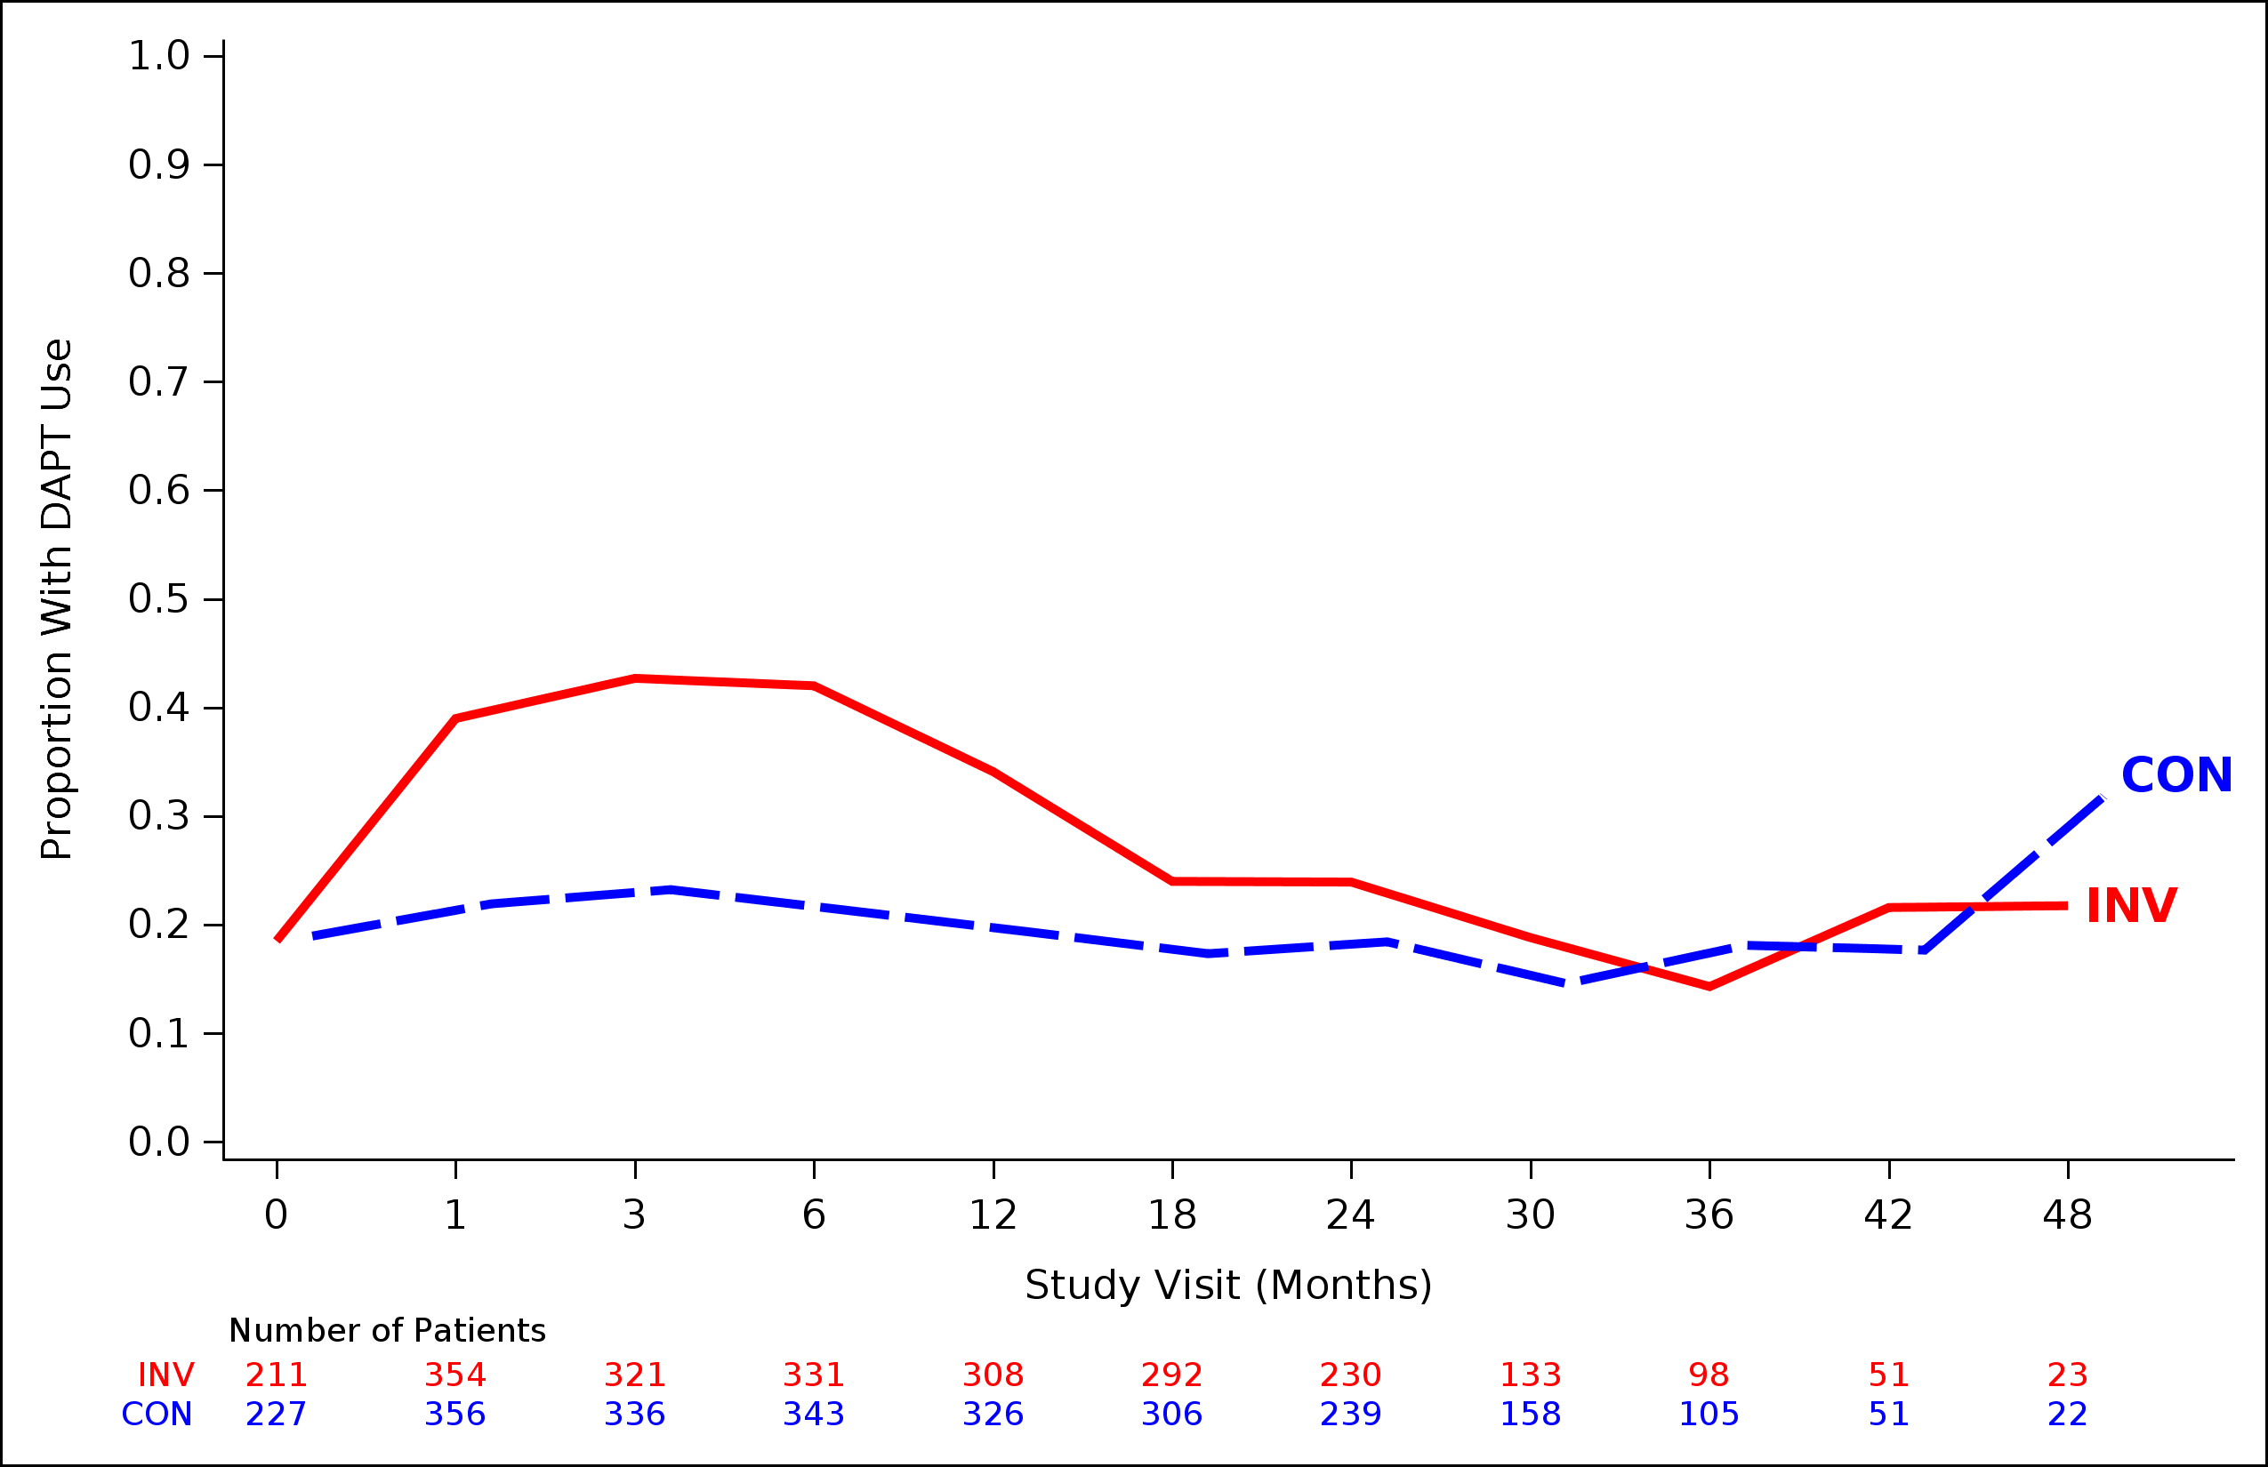
Medications
Beta-blockers
CCBs
Other Anti-anginals
DAPT
Notes:
Footnote

Slide 14
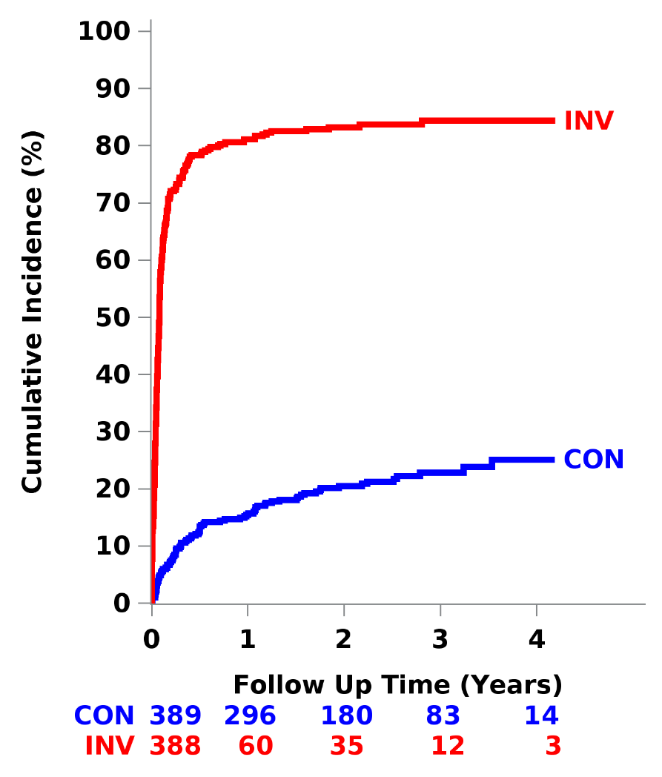
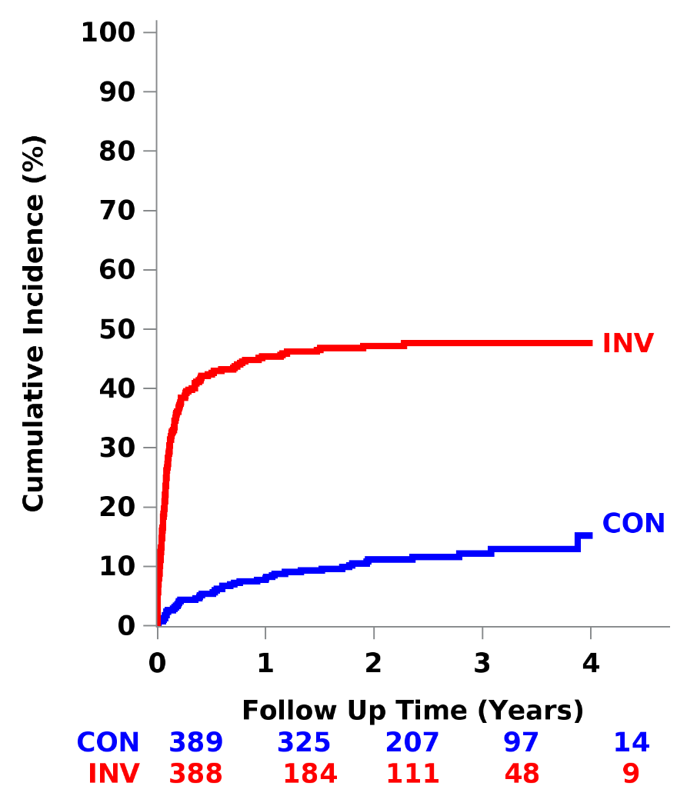
Coronary Angiography and Revascularization*
Coronary Angiography
Revascularization
85%
85% PCI; 15% CABG
50%
22%
12%
*Not preceded by endpoint event

Slide 15
Primary End Point Death or MI
HR_{adj} = 1.01 (0.79, 1.29)
P-value = 0.95
CON
Bayesian Analysis: HR_{adj}=1.01 95% CrI (0.79-1.29)
Probability HR <0.90: 19%
INV
36.7%
36.4%
Subjects at Risk
CON | 389 | 330 | 213 | 91 | 13
INV | 388 | 323 | 190 | 80 | 18

Slide 16
Major Secondary End Point Death, MI, Hospitalization for Unstable Angina or Heart Failure or Resuscitated Cardiac Arrest
HR_{adj} = 1.01 (0.79, 1.29)
P-value = 0.93
CON
Bayesian Analysis: HR_{adj}=1.02 95% CrI (0.79-1.29)
Probability HR <0.90: 17%
INV
39.7%
38.5%
Subjects at Risk
CON | 389 | 326 | 206 | 87 | 13
INV | 388 | 315 | 183 | 77 | 18

Slide 17
Secondary End Points
Death
CV Death
HR_{adj} = 1.02 (0.76, 1.35)
P-value = 0.91
HR_{adj} = 0.97 (0.71, 1.33)
P-value = 0.84
Bayesian Analysis: HR_{adj}=1.03 95% CrI (0.76-1.36)
Probability HR <0.90: 20%
INV
CON
27.2%
CON
INV
27.8%

Slide 18
Secondary End Points
Myocardial Infarction
HR_{adj} = 0.84 (0.57, 1.25)
P-value = 0.39
CON
INV

Slide 19
Secondary End Points
Procedural MI
Spontaneous MI
HR_{adj} = 2.03 (0.59, 7.01)
P-value = 0.26
HR_{adj} = 0.72 (0.47, 1.09)
P-value = 0.12
CON
INV
INV
CON

Slide 20
Secondary End Points
Unstable Angina
Heart Failure
HR_{adj} = 0.15 (0.02, 1.37)
P-value = 0.09
HR_{adj} = 1.47 (0.69, 3.12)
P-value = 0.31
INV
CON
CON
INV

Slide 21

Secondary End Point
Stroke
HR_{adj} = 3.76 (1.52, 9.32)
P-value = 0.004
INV
CON
Procedural (<30 days)
INV
CON

Slide 22
Safety End Points*
Death or New Dialysis
New Dialysis
HR_{adj} = 1.47 (0.88, 2.44)
P-value = 0.13
HR_{adj} = 1.48 (1.04, 2.11)
P-value = 0.02
INV
INV
CON
CON
AKI after cath/PCI | 7.8% | 5.4%
Dialysis after CABG | 12.5% | 11.1%
Dialysis <30 days after procedure | 2.1% | 0.6%
INV
CON
* In those not on dialysis at baseline

Slide 23
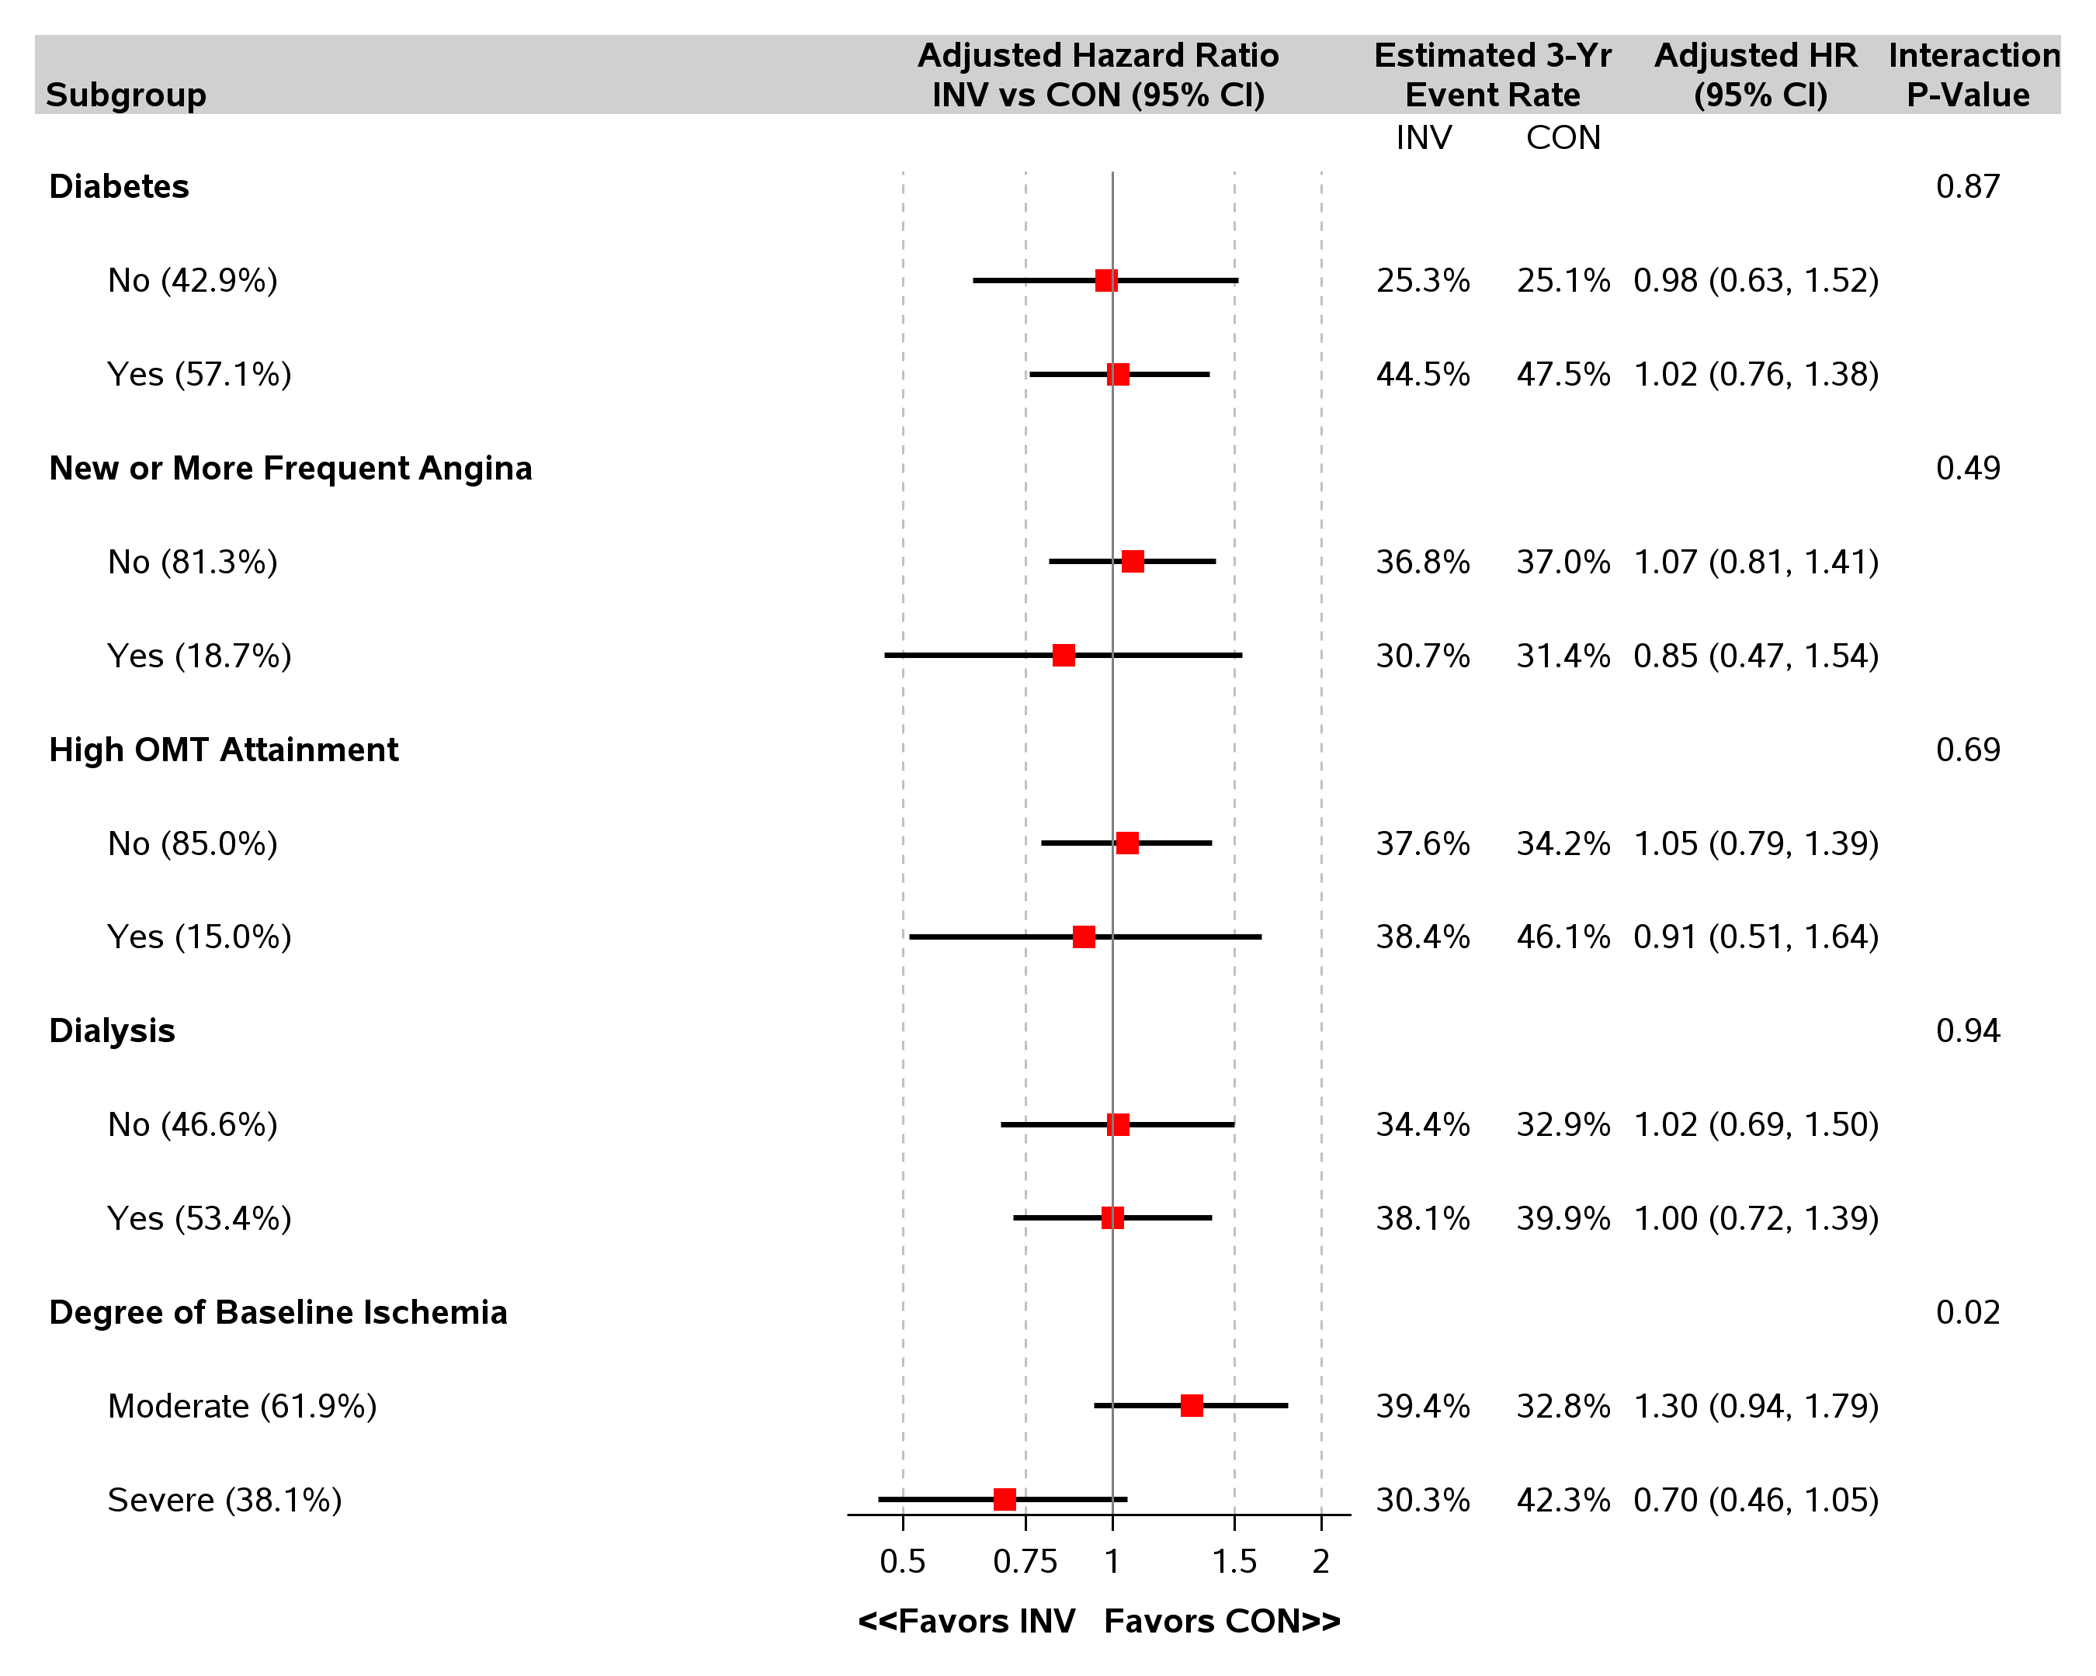
Heterogeneity of Treatment Effect Death or MI

Slide 24
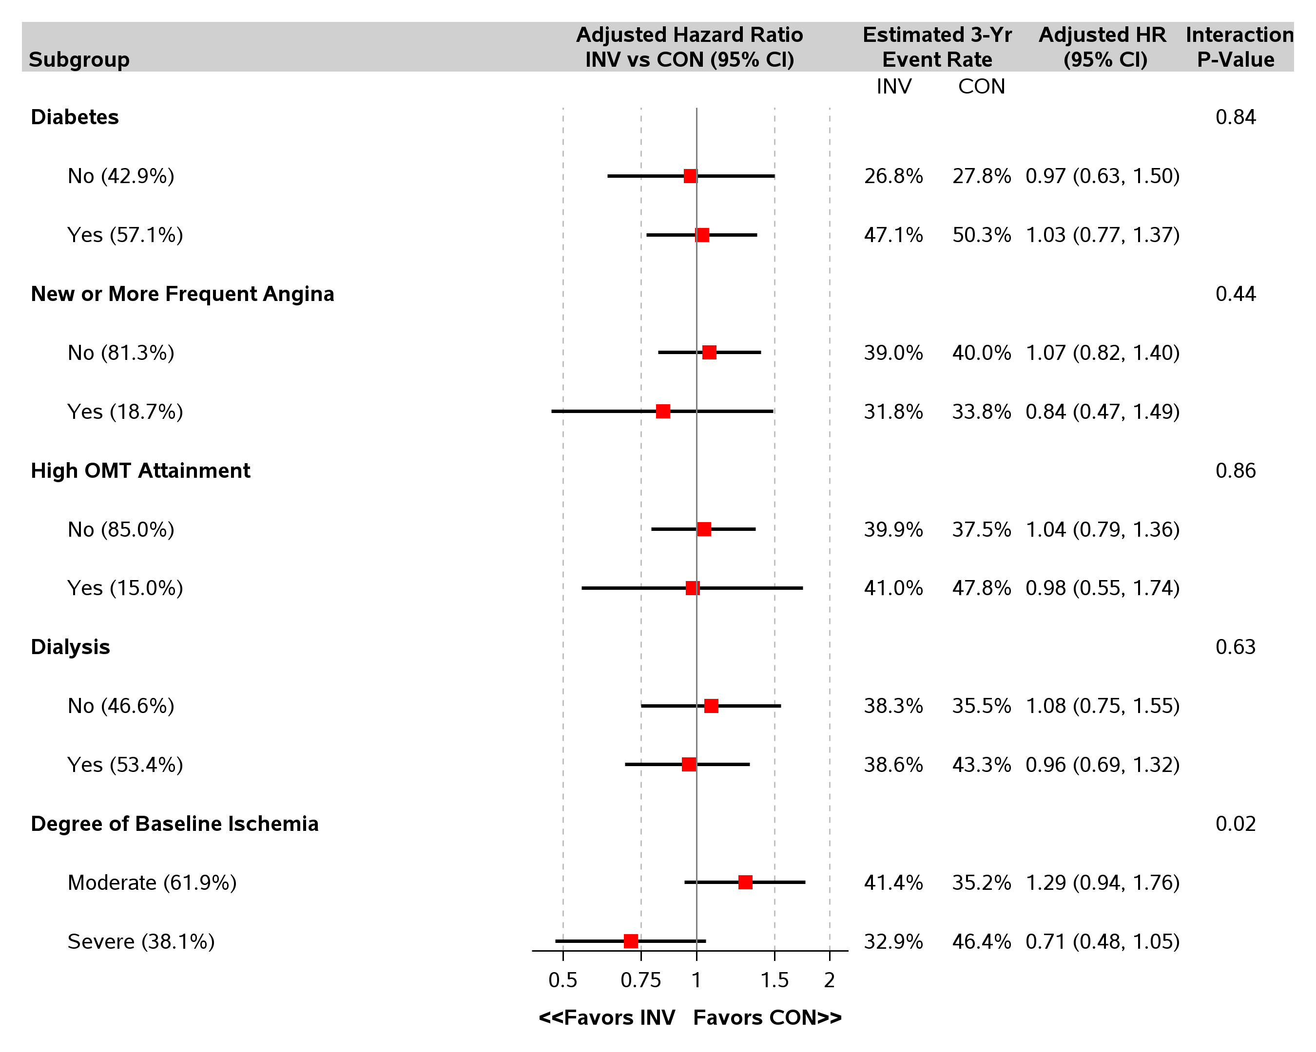
Heterogeneity of Treatment Effect Death, MI, Hospitalization for Unstable Angina or Heart Failure or Resuscitated Cardiac Arrest

Slide 25
Study Limitations
Low rates of revascularization in the invasive arm
Sensitivity and specificity of stress testing in CKD cohort is poor
No requirement for CCTA in the trial
Based on exclusion criteria, the trial results do not apply to patients with:
Acute coronary syndromes within 2 months
Highly symptomatic patients
LVEF <35%
Sites were specifically trained to minimize risk of AKI after cardiac catheterization and revascularization.
Trial findings not generalizable to centers with higher complication rates

Slide 26
Conclusions
Largest trial of invasive vs. conservative strategy in patients with advanced CKD and SIHD
Low rates of procedural complications (stroke, AKI)
Overall, an initial invasive strategy did not demonstrate a reduced risk of clinical outcomes as compared with an initial conservative strategy

Slide 27
We thank the investigators, the study coordinators and especially the participants in the trial
NHLBI
Jerome L. Fleg
Ruth Kirby
Steering Committee
Sripal Bangalore
Judith Hochman (ISCHEMIA trial Chair)
David Maron (ISCHEMIA trial Co-Chair)
Glenn Chertow
William Boden
Bruce Ferguson
Robert Harrington
Gregg Stone
David O. Williams
Renal Committee
Charles Herzog
David Charytan
Glenn Chertow
Peter McCullough
Roxana Mehran
Carlo Briguori
CCC Faculty
Jeffrey Berger
Roy Mathew
Jonathan Newman
Harmony R. Reynolds
Mandeep Sidhu
CCC
Stephanie Mavromichalis
Gia Cobb
Stephanie Ferket **
Andre Gabriel**
Diana Cukali**
Kevin McMahon**
Ahmed Ayoub**
Matthew Shinseki**
Paula Wilson**
Solomon Yakubov**
Mark Xavier
SDCC
Sean O’ Brien
Frank Rockhold
Sam Broderick
Zhen Huang
Lisa Hatch
Wayne Pennachi
Khaula Baloch
Michelle McClanahan-Crowder
Matthew Wilson
Jeff Kanters
Dimitrios Stournaras
Allegra Stone
Linda Lillis
Site PIs (≥10 randomized)
Alexander M. Chernyavski
Alexander Borisov (N)
Tomasz Mazurek
Carlo Briguori
Leo A. Bockeria
Evgeny Shutov (N)
Mayil S. Krishnam
Kevin T. Harley (N)
Wei Ling (N)
Piotr Pruszczyk
Marcin Demkow
Robert Malecki (N)
Juan Manuel López Quijano
Alejandro Chevaile Ramos (N)
Patricia Pellikka
Kian-Keong Poh
Titus Lau (N)
Michael Chobanian (N)
Shao-ping Nie
Jiyan Chen
Xin Fu
Shuyang Zhang
Chakkanalil Sajeev
Atul Mathur
Eapen Punnoose
Ranjan Kachru
Kevin Bainey
Harmony Reynolds
Kreton Mavromatis
Aleksandras Laucevicius
Andras Vertes
Jorge Escobedo
Anjali Acharya
Melemadathil Srilatha (N)
Hong Cheng (N)
Wei Ling Lau (N)
Alejandro Chevaile (N)
Neesh Pannu (N)
Zhiming Ye (N)
LaTonya Hickson (N)
Olga Zhdanova (N)
Zhangsuo Liu (N)
Ajit Narula (N)
Harold Franch (N)
Kishore Dharan (N)
Bidhun Kuriakose (N)
Satish Sankaranarayanan (N)
Marius Miglinas (N)
Xuemei Li (N)
Sanjeev Gulati (N)
SC Tiwari (N)
Titus Lau (N)
Peter Voros (N)
Maria Juana Perez Lopez (N)
Angiographic Core Lab
Ziad Ali
Philippe Genereux
Maria A. Alfonso
Michelle Cinguina
Maria P. Corral
Nicoleta Enache
Javier J. Garcia
Katharine Garcia
Jennifer Horst
Ivana Jankovic
Maayan Konigstein
Mitchel B. Lustre
Yolayfi Peralta
Raquel Sanchez
ECG/ETT Core Lab
Bernard Chaitman
Bandula Guruge
Jane Eckstein
Mary Streif
CEC
Bernard Chaitman
Salvador Cruz-Flores
Eli Feen
Mario J. Garcia
Lisa Alderson
Eugene Passamani
Maarten Simoons
Hicham Skali
Kristian Thygesen
David Waters
Ileana Pina
Device donations:
Abbott Vascular
Medtronic, Inc.
St. Jude Medical, Inc.
Phillips Co.
Omron Healthcare, Inc

Slide 28
Country Leaders
Country Lead Cardiologist Lead Nephrologist
Argentina Dr. Luis Guzman Dr. Rafael Maldonado
Australia Dr. Joseph Selvanayagam Dr. Magid Fahim
Austria Dr. Herwig Schulenz
Belgium Dr. Kathleen Claes
Brazil Dr. Renato Lopes Dr. Maria Eugenia Canziani and Dr. Sergio Draibe
Canada Dr. Akshay Bagai and Dr. Kevin Bainey Dr. Ron Wald
China Dr. Lixin Jiang Dr. Xuemei Li
France Dr. Emmanuel Sorbets Dr. Eric Daugas
Germany Dr. Rolf Doerr
Hungary Dr. Andras Vertes Dr. Peter Voros
India Dr. Balram Bhargava Dr. Sandeep Mahajan
Italy Dr. Francesco Orso
Lithuania Dr. Jelena Celutkiene Dr. Marius Miglinas
Macedonia Dr. Sasko Kedev
Mexico Dr. Jorge Escobedo Dr. Magdelena Madero
New Zealand Dr. Gerard Devlin Dr. Peter Sizeland
Peru Dr. Walter Mogrovejo Dr. Luis Orrego Guerrero
Poland Dr. Radec Pracon and Dr. Marcin Demkow Dr. Robert Malecki
Portugal Dr. Ruben Ramos Dr. Fernando Nolasco
Russia Dr. Olga Bockeria Dr. Evgeny Shutov
Serbia Dr. Branko Beleslin Dr. Sanja Simic Ogrizovic
Singapore Dr. Kian Keong Poh Dr. Titus Lau
Spain Dr. Almudena Castro Dr. Rafael Selgas
Sweden Dr. Claes Held
Thailand Dr. Srun Kuansapert Dr. Kajornsak Noppakun
UK Dr. David Wheeler
US-VA/North Region Dr. Mandeep Sidhu Dr. Roy Mathew

Slide 29
Coronary Angiography and Revascularization in CON

Slide 30
Reasons for No Cardiac Catheterization in Invasive
Notes:
Add N under title

Slide 31
Reasons for No Revascularization after Cath in INV
N=134
Notes:
Add number of no revasc

