Slide 1
Whole-Heart Atherosclerosis Quantification and Characterization and Risk of Major Adverse Cardiovascular Events: The ISCHEMIA Trial
James K. Min, MD, Harmony R. Reynolds, MD, Rebecca Anthopolos, DrPH, Tami Crabtree, MS, G.B. John Mancini, MD, Jonathon Leipsic, MD,
Matthew J. Budoff, MD, Cameron Hague, MD, Sean M. O'Brien, PhD,
Gregg W. Stone, MD, Jonathan D. Newman, MD, MPH, William E. Boden, MD, Bernard R. Chaitman, MD, Peter H. Stone, MD, Sripal Bangalore, MD, MHA, John A. Spertus, MD, MPH, Daniel B. Mark, MD, MPH, Leslee J. Shaw, PhD, Judith S. Hochman, MD, David J. Maron, MD
Presented by Harmony Reynolds on Behalf the ISCHEMIA Research Group

Slide 2
Disclosures
Research Support for ISCHEMIA trial
NIH U01 HL105907, HL105462, HL105561
Devices or medications were provided by Abbott Vascular, Medtronic, St. Jude Medical, Volcano, Amgen, Arbor Pharmaceuticals, AstraZeneca Pharmaceuticals, Espero Pharmaceuticals, Merck Sharp & Dohme, Omron Healthcare, and Sunovion Pharmaceuticals
Harmony Reynolds
NIH funding for work on the ISCHEMIA trial
In-kind donations from Abbott Vascular, Siemens and BioTelemetry
James Min
Employee / Equity in Cleerly, Inc, where CT quantification analyses were performed
Scientific Advisory Board, Arineta
Funding by NIH for work on the ISCHEMIA trial

Slide 3
Study Objective
To determine whether quantification and characterization of coronary atherosclerosis, as determined by
coronary computed tomographic angiography (CCTA),
would further improve identification of individuals at risk for the composite outcome of cardiovascular death or MI
in the ISCHEMIA randomized trial cohort

Slide 4
Background
Prior multicenter studies have demonstrated atherosclerosis to be a strong predictor of future major adverse cardiovascular events (MACE)
CONFIRM¹, ICONIC², SCOT-HEART³ and PROMISE⁴
Specifically, “high-risk” plaques – those that exhibit low-density non-calcified plaque composition and positive (outward) arterial remodeling – have been linked to future MACE¹⁻⁴.
Additional 3D atherosclerosis and vascular morphology measures are correlated with adverse outcomes:
Plaque burden and morphology
Plaque location
Plaque diffuseness
3D Lumen volume
¹Hadamitzky M et al. J Am Coll Cardiol 2013; ²Chang HJ et al. J Am Coll Cardiol 2018; ³Williams M et al. Circulation 2020; ⁴Ferencik M et al. JAMA Cardiology 2018

Slide 5
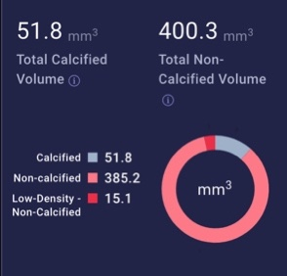
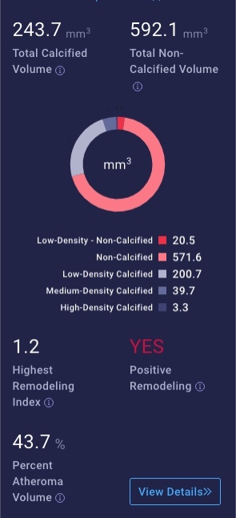
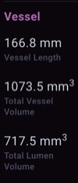
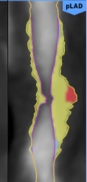
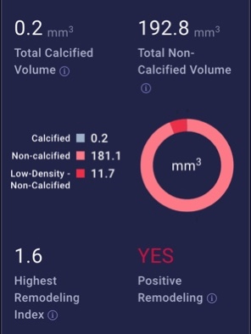
Methods – Atherosclerosis Quantification Performed on Every Coronary Artery and Branches
Total plaque volume
Low-density non-calcified plaque volume
Diffuse plaque w/ # of >30% stenosis
Proximal Location
Lumen volume/vessel length
Low Density: <30HU
High-risk plaque:
Remodeling index >1.1 & low density plaque
Performed using software as a service at Cleerly, Inc
Notes:
This is total burden athero on left depicted in color. This person

Slide 6
Statistical Methods
For this analysis, the primary endpoint was CV death or MI (number of events=399)
Three time points (based on primary trial event curves): 6 months, 2 years, 4 years
Candidate predictors:
(a) Clinical
(b) Quantitative stenosis severity (number of vessels diseased)
(c) Quantitative atherosclerotic and vascular morphology variables
Used cause-specific Cox regression models to estimate predictor-outcome associations and calculate individual patient risk scores, accounting for non-CV death as a competing risk
Risk prediction models compared based on discrimination ability, quantified by the area under the receiver operating characteristics curve (AUC; aka C-statistic)

Slide 7
Baseline Study Characteristics: n=3847
Variable | % or Median (Q1, Q3)
Age, years (median, interquartile range [IQR]) | 64 (58, 70) years
Male | 79%
Smoking, current | 13%
Smoking, former | 45%
Diabetes | 41%
Hypertension | 70%
Family history of premature CAD | 27%
Prior CVD (prior CABG, PCI, MI, or carotid surgery or stent) | 20%
eGFR | 85 (73, 100) mL/min
Ejection fraction (median, IQR) | 60 (56, 65)
98.3% (3847 / 3913) participants from ISCHEMIA with CCTA (protocol or non-protocol)
n=66 CCTAs could not be located (clinical characteristics did not differ from analyzed participants)

Slide 8
CT Angiographic Results
(Trial Core Laboratory Visual Stenosis Estimation)
Variable | % or Median (Q1, Q3) | Definition
Segment Involvement Score | 12 (10-13) | # segments w/ stenosis (max=16)
CT Angiographic Stenosis (Visual Estimation)
Non-obstructive | 0% | # vessels with ≥50% stenosis
1VD | 18%
2VD | 24%
3VD | 35%
Non-Evaluable | 23%

Slide 9
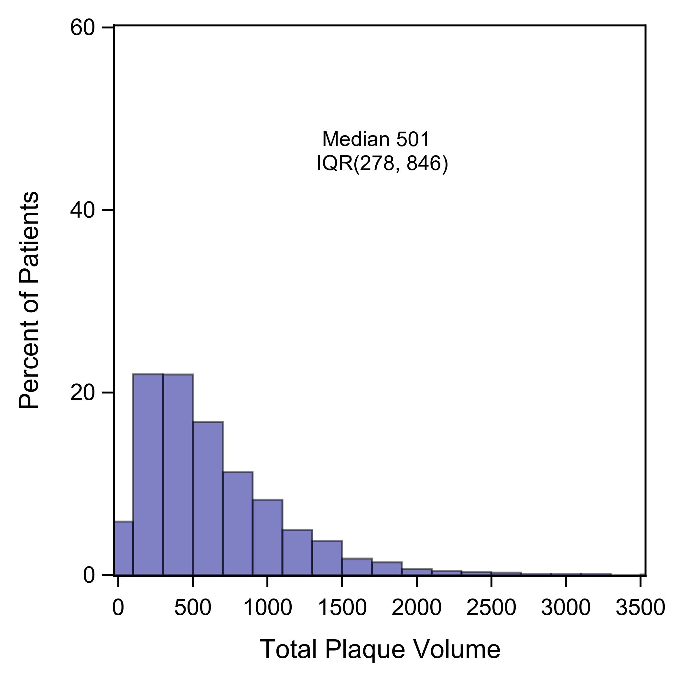
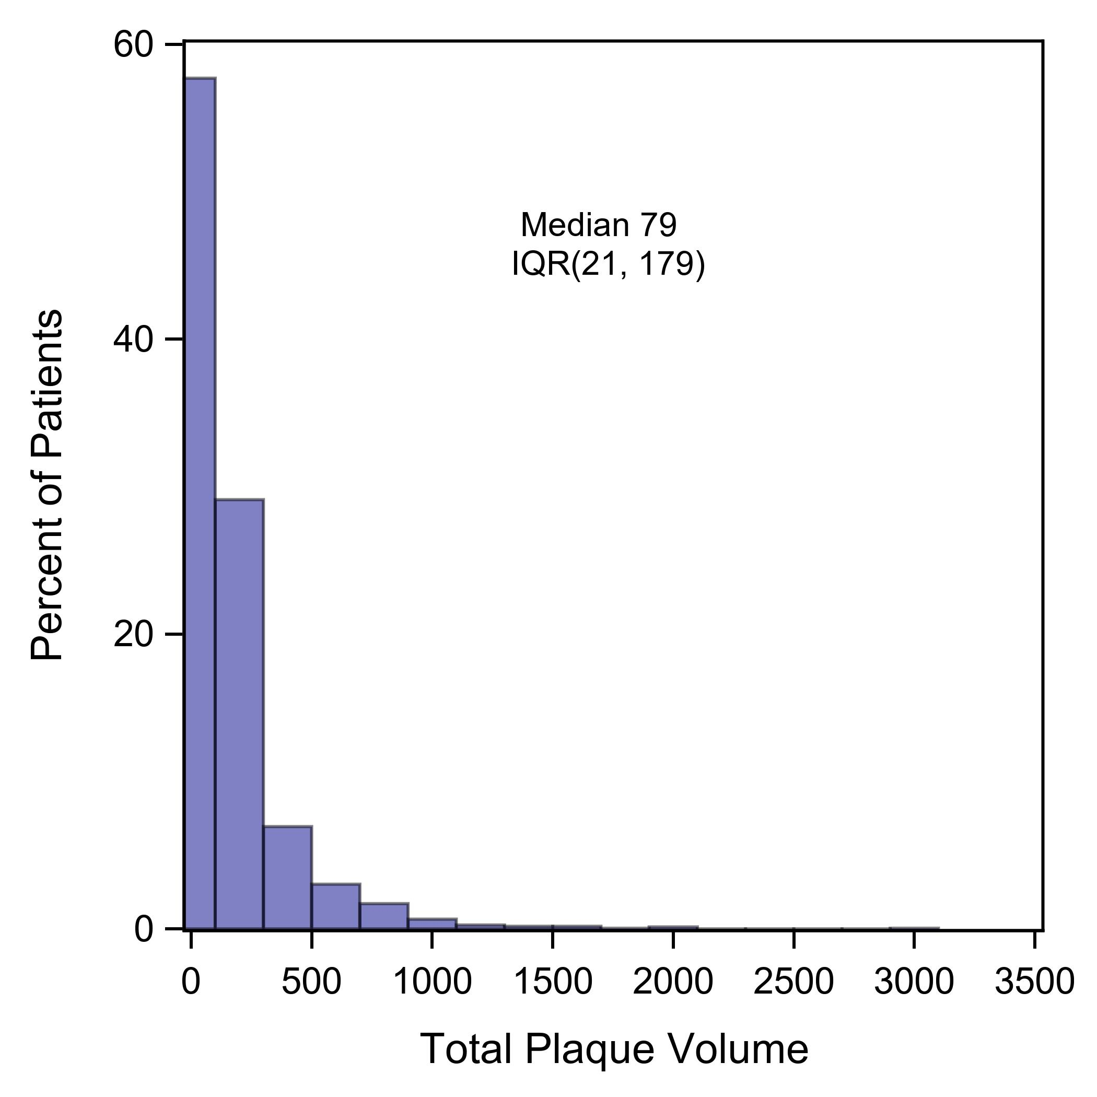
Median ISCHEMIA Participant Total Plaque Volume:
>90th Percentile for the General Population
ISCHEMIA Trial
(Moderate or Severe Ischemia, N=3847)
Miami Heart Study
(Population-Based,
N=2277)
Median
501 mm³
(IQR 278, 846)
Median
79 mm³
(IQR 21, 179)
Preliminary Data from the Miami Heart Study (NCT02508454), Courtesy of Khurram Nasir and Jonathan Fialkow

Slide 10
CAD Characteristics: Extent, Severity, Type, Volume
Quantitation Variable | % or Median (Q1, Q3) | Definition
Total Plaque Volume | 501 mm³ (278, 846) | Volume of atherosclerosis, mm³
Low-Density Non-Calcified Plaque Volume | 6 mm³ (2, 16) | Volume of atherosclerosis w/ HU < 30, mm³
Number of High-Risk Plaques (HRP) | 1 (0, 3) | Number of plaques with <30 HU with positive remodeling (index >1.1)
Number of Lesions with >30% Stenosis (Diffuseness) | 4 (2, 6) | Number of atherosclerotic lesions across vessel length
Proximal Segments: Non-calcified Plaque Volume | 198 mm³ (119, 312) | Volume of NCP in proximal LAD, LCx and RCA or mid LAD
Remodeling Index >1.5 (any lesion) | 39% | Maximum vessel diameter at lesion / normal reference diameter >1.5
3D Lumen Volume Narrowing | 3 (3, 4) mm² | Lumen volume / vessel length
Narrow distribution of CAD, with very few mildly abnormal scans
7.8% of >32,000 vessels could not be included in quantitative analysis of atherosclerosis/vascular morphology due to artifact (calcium, motion, etc)

Slide 11
Univariable Hazard Ratios for CV Death or MI
Variable | Hazard Ratio (95% Confidence Interval) | P Value
Number or Vessels Diseased by Quantitative CT Stenosis (reference: no quantitative >50% stenosis)
1VD 2VD 3VD | 1.03 (0.76-1.40) 1.48 (1.09-2.01) 2.22 (1.63-3.04) | <0.001
Atherosclerotic (HR is for top to bottom tertile) |  | P across tertiles
Total Plaque Volume | 2.39 (1.84-3.11) | <0.001
Low Density NCP (LD-NCP) Volume | 1.39 (1.09-1.78) | 0.027
Volume of Proximal, Non-Calcified Plaque | 1.36 (1.07-1.73) | 0.028
Number of High-Risk Plaques | 1.59 (1.28-1.97) | <0.001
Remodeling Index >1.5 in Any Lesion vs. Not | 1.37 (1.12-1.66) | 0.002
Diffuseness (Number of Lesions >30% Stenosis) | 1.96 (1.54-2.50) | <0.001
Lumen Volume / Length | 0.61 (0.48-0.79) | <0.001

Slide 12
Multivariable Hazard Ratios for CV Death and MI
 | Clinical |  | Number of Vessels with ≥50% Stenosis (Quantitative Analysis) |  |  | Atherosclerotic Quantitation | Atherosclerotic
Variable | Hazard Ratio (95% CI) | P | Value | Hazard Ratio (95% CI) | P | Variable | Hazard Ratio (95% CI) | P
Age | 1.12 (0.93, 1.34) | 0.23 | No ≥50% stenosis | reference | 0.001 | Total Plaque Volume | 1.59 (1.24, 2.03) | 0.001
Female Sex | 1.06 (0.78, 1.44) | 0.71 | 1VD | 1.05 (0.73-1.50) |  | Low Density NCP Volume | 1.14 (0.97, 1.34) | 0.12
Diabetes | 1.22 (0.97, 1.52) | 0.09 | 2VD | 1.18 (0.80-1.75) |  | Proximal NCP Volume | 0.79 (0.62, 1.00) | 0.047
Hypertension | 1.84 (1.36, 2.48) | 0.001 | 3VD | 1.66 (1.08-2.56) |  | Number of High Risk Plaques | 1.13 (0.93, 1.37) | 0.21
Smoking (Current) | 1.10 (0.86, 1.41) | 0.74 |  |  |  | Remodeling index > 1.5 | 0.96 (0.75, 1.24) | 0.77
Prior CVD | 1.10 (0.84, 1.43) | 0.49 |  |  |  | Diffuseness (Number of Lesions >30% Stenosis) | 1.01 (0.85, 1.21) | 0.88
eGFR | 0.92 (0.78, 1.08) | 0.31 |  |  |  | Lumen Volume / Length | 0.74 (0.62, 0.88) | 0.001
LVEF | 0.88 (0.77, 0.99) | 0.032
N = 3329. Skewed continuously measured variables were modeled with a square root transformation. All continuously measured variables were scaled to represent an interquartile increase from the 25th percentile to the 75th percentile. Data are preliminary.

Slide 13
Discrimination of Prediction Model
6 Month CVD/MI
2 Year CVD/MI
4 Year CVD/MI
Model | AUC (95%CI) | P (Δ-AUC)
Clinical | 64% (59-68) | -
QCT Number of Vessels ≥50% added | 68% (63-72) | 0.007 vs. clinical
Quant. Athero. added | 69% (64-74) | 0.36 vs. clinical + stenosis
Model | AUC (95%CI) | P (Δ-AUC)
Clinical | 61% (58-65) | -
QCT Number of Vessels ≥50% added | 65% (61-68) | 0.006 vs. clinical
Quant. Athero. added | 67% (63-71) | 0.09 vs. clinical + stenosis
Model | AUC (95%CI) | P (Δ-AUC)
Clinical | 60% (55-65) | -
QCT Number of Vessels ≥50% added | 61% (56-66) | 0.32 vs. clinical
Quant. Athero. added | 65% (60-70) | 0.002 vs. clinical + stenosis
Overall: Discrimination accuracy was modest
Possible time-dependent effects
Near-Term: CT number of vessels diseased improved risk prediction at 6 months and 2 years
Long-Term: Atherosclerosis and vascular morphology quantification improved risk prediction at 4 years

Slide 14
Conclusions
ISCHEMIA enrolled patients with very high plaque burden, including numerous high-risk atherosclerotic plaque features as defined by prior studies
Several atherosclerotic and vascular morphology features were associated with CV death or MI in follow up:
Plaque volume and morphology, high-risk plaque, proximal plaque location, plaque diffuseness, number of vessels diseased, lumen volume
Total plaque volume, number of vessels diseased and smaller lumen volume were associated with CV death or MI independent of clinical risk factors
Overall, accuracy of discrimination of risk of CV death or MI was modest
Additional analyses are ongoing; data are preliminary

Slide 15
THANK YOU

