Slide 1


Association of Medication Adherence with Health Status Outcomes:
Insights from the ISCHEMIA Trial
R. Angel Garcia DO, Mary C. Benton PhD, John A. Spertus MD MPH, Philip G. Jones MS, Daniel B. Mark MD MPH, Jonathan D. Newman MD MPH, Sripal Bangalore MD MHA, William E. Boden MD, Gregg W. Stone MD, Harmony R. Reynolds MD, Judith S. Hochman MD, David J. Maron MD on behalf of the ISCHEMIA Research Group

Slide 2

DISCLOSURES
Dr. Spertus owns the copyright to the SAQ. Unrelated to this work, he serves as a consultant on patient-reported outcomes to Janssen, Pfizer, Bristol Meyers Squibb, Bayer, Merck, Novartis, Corvia, Terumo and Abbott. He has research grants from the American College of Cardiology Foundation, Janssen, Myokardia and Abbott Vascular. He owns the copyright to the KCCQ and SAQ and serves on a scientific advisory board for United Healthcare and the Board of Directors of Blue Cross Blue Shield of Kansas City.
Dr. Bangalore has served as a consultant to Abbott Vascular, Biotronik, Pfizer, Amgen and received research grants from NHLBI and Abbott Vascular.
Dr. Reynolds reports funding from the National Heart, Lung and Blood Institute, and in-kind donations for unrelated research from Abbott Vascular, Siemens and BioTelemetry.
Dr. Newman reports funding from the National Heart, Lung and Blood Institute.
Dr. Stone has received speaker honoraria from Cook, Infraredx; has served as a consultant to Valfix, TherOx, Robocath, HeartFlow, Ablative Solutions, Vectorious, Miracor, Neovasc, Abiomed, Ancora, Elucid Bio, Occlutech, CorFlow, Apollo Therapeutics, Impulse Dynamics, Reva, Vascular Dynamics, Shockwave, V-Wave, Cardiomech, Gore; and has equity/options from Ancora, Cagent, Applied Therapeutics, Biostar family of funds, SpectraWave, Orchestra Biomed, Aria, Cardiac Success, Valfix, MedFocus family of funds.

Slide 3

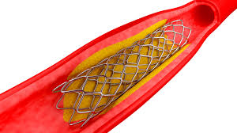
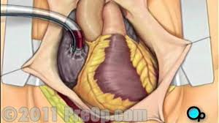




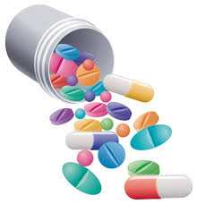
Background: ISCHEMIA Trial
INVASIVE
PCI
CABG
or
+
Outcomes
CONSERVATIVE
Stable Coronary Disease,
Moderate-to-Severe Reversible Ischemia
Clinical = CV Death/MI/UA/HF/SCD
Health Status = Symptoms and QoL
N Engl J Med 2020; 382:1395-1407 DOI: 10.1056/NEJMoa1915922

Slide 4
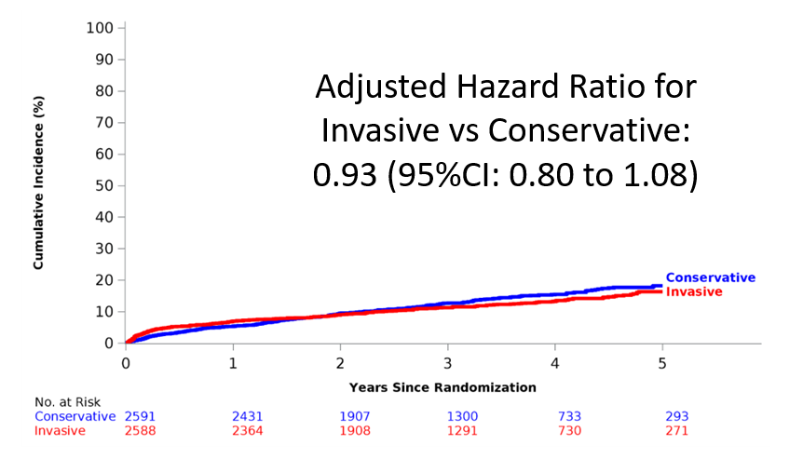
N Engl J Med 2020; 382:1395-1407 DOI: 10.1056/NEJMoa1915922

Slide 5
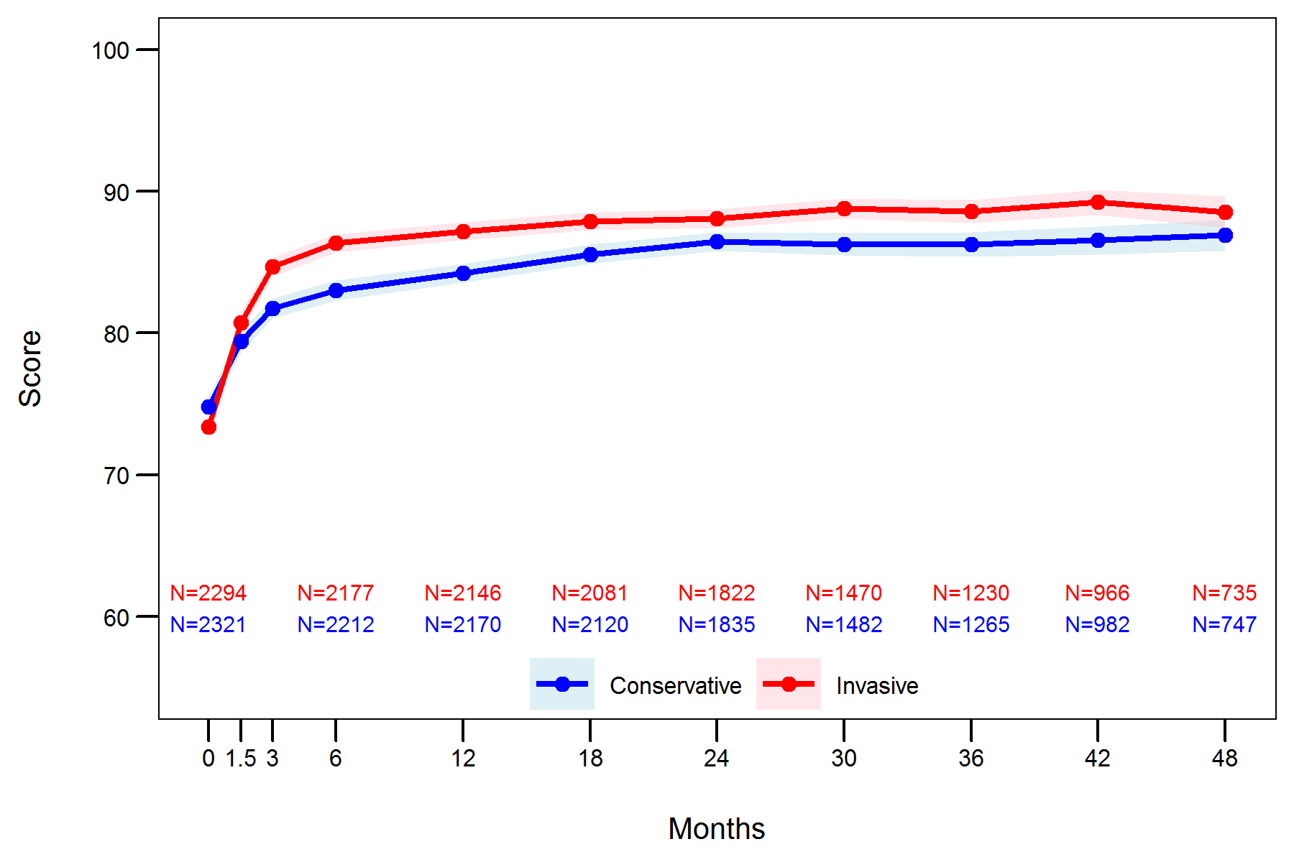
SAQ Summary Score
N Engl J Med 2020; 382:1408-1419 DOI: 10.1056/NEJMoa1916370
Notes:
Here is an overview of the health status outcomes for the original ISCHEMIA trial
- Health status outcomes were determined by the seattle angina questionnaire (or SAQ). The SAQ summary score was then used to describe the health status of patients with coronary artery disease. Note, that higher scores means better health status, or better symptoms function and quality of life
SAQ summary scores increased in both treatment groups, but were significantly higher in the invasive treatment arm
with an increase of 4.1 points at both 3 and 12 months, and an increase of about 3 points at 3 years higher with the invasive strategy than with the conservative strategy

Slide 6
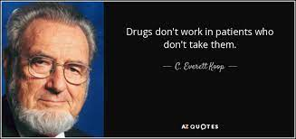
STUDY AIMS & METHODS
or
PRIMARY OUTCOME
Adherent
+
Aim 1
Non-Adherent
12-Mo. SAQ
Summary Score
Aim 2
Non-Adherent
Aim 1
Adherent
Aim 1: Is health status worse in non-adherent pts?
Aim 2: Do non-adherent pts do better with invasive Rx?

Slide 7
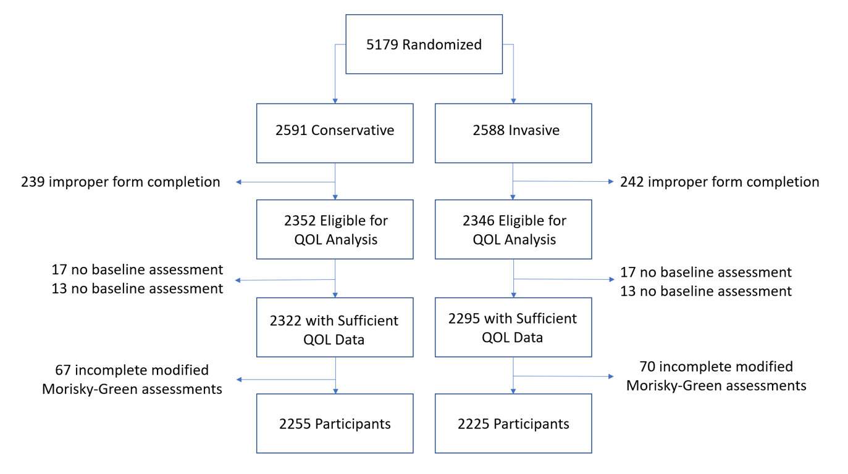
N Engl J Med 2020; 382:1395-1407 DOI: 10.1056/NEJMoa1915922
Notes:
- Of the 5179 participants originally enrolled in ISCHEMIA, the initial exclusion criteria in our study was the same as in the original ISCHEMIA trial, resulting in 2591 and 2588 participants in the conservative and invasive arms.
4617 participants completed quality of life assessments at baseline and at least once upon follow up
And after exclusion of those with incomplete modified Morisky-Green-Levine Adherence Scale assessments our final cohort included 2255 and 2225 participants in the conservative and invasive arms.

Slide 8
Primary Exposure: Medication Adherence as per the
Modified Morisky-Green-Levine Adherence Scale
 | Strongly Disagree | Disagree | Agree | Strongly Agree | Don’t Know | Refused
I sometimes forget to take my medicines
I am sometimes careless about taking my medicines
When I feel better, I sometimes stop taking my medicines
If I feel worse when I take my medicine, sometimes I stop taking it
Adherent
Non-Adherent
Notes:
Adherence determined by the Morisky-Green-Levine Adherence Scale
Where adherent and non-adherent are described as above

Slide 9
Baseline Characteristics
Characteristics that differed:
Characteristic | Adherent N=3235 (72%) | Non-Adherent N=1245 (38%)
Age | 64.7 (9.5) | 63.6 (9.4)
Current Smoker | 11.9% | 16.4%
SAQ Summary | 74.9 (18.5) | 71.9 (19.6)
SAQ Physical Limitation | 80.3 (23.1) | 76.9 (24.4)
SAQ Quality of Life | 62.9 (25.9) | 58.9 (27.2)
Patient Sex, Comorbidities, were similar, in addition to
# diseased vessels, degree of ischemia, # anti-anginal meds, SAQ Angina Frequency score

Slide 10
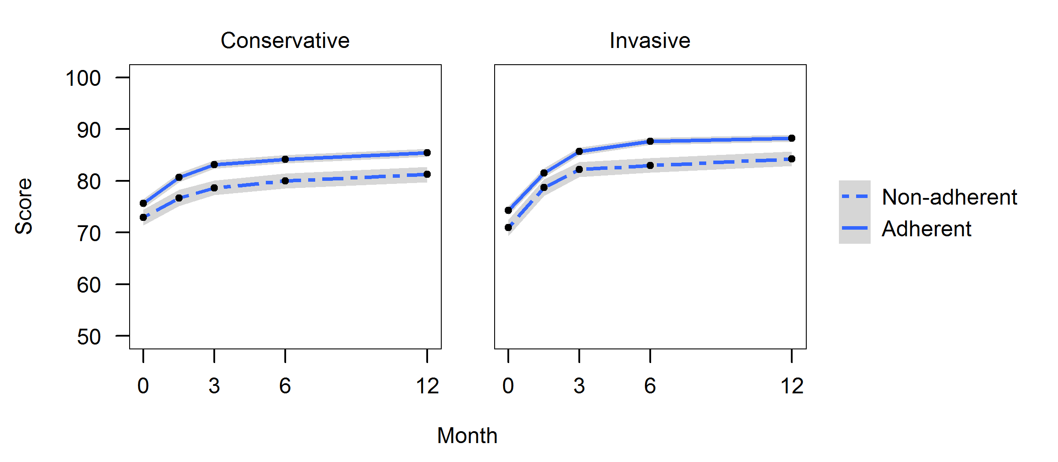
Aim 1: Are Health Status Outcomes Worse
In Non-Adherent Participants?
SAQ-7 Summary Score

Slide 11
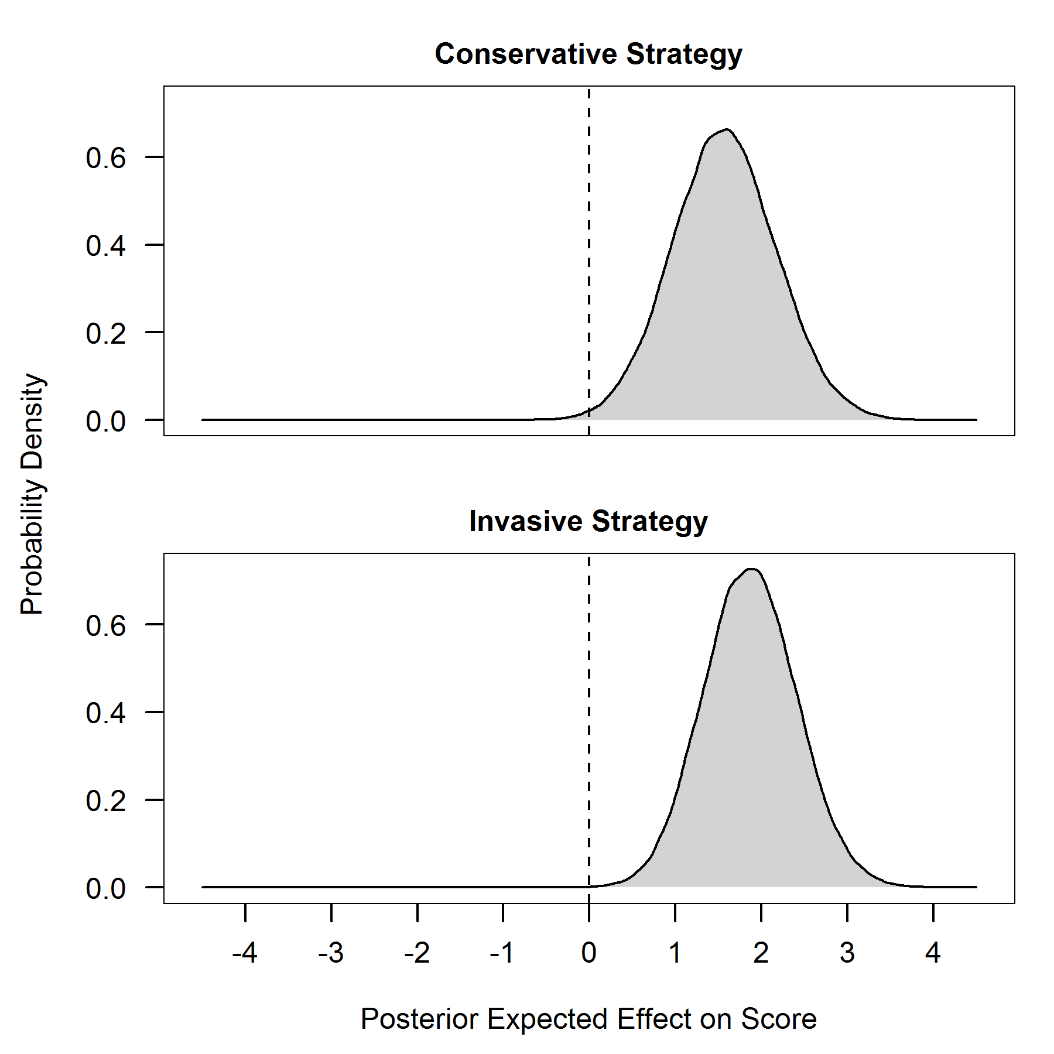
Aim 2: Do Non-Adherent Patients Do Better
with Invasive Treatment?
Mean Difference in 12-Mo SAQ SS: 1.6 points
95% CrI = (0.4, 2.8)
Mean Difference in 12-Mo SAQ SS: 1.9 points
95% CrI = (0.8, 2.9)
Favors
Non-Adherence
Favors
Adherence

Slide 12
Limitations
CONCLUSIONS
The ISCHEMIA trial enrolled a carefully screened population of patients with chronic coronary disease
Medication adherence was assessed only at baseline using only self-report
Modifications made to the original Morisky-Green-Levine Adherence Scale
  However, modifications were collapsed to be concordant with original scale

Slide 13
Summary
CONCLUSIONS
More than 1 in 4 patients were not adherent
Non-adherence associated with poorer health status
  Both invasive and conservative arms
Invasive arm demonstrated health status benefits
  Both adherent and non-adherent patients
Improving adherence has the potential to improve health status outcomes, regardless of treatment strategy

Slide 14
THANK YOU

