Slide 1
Prognostic Impact Of Myocardial Infarct Type In The ISCHEMIA Trial
Bernard Chaitman, Karen Alexander, Derek Cyr, Jeffrey Berger, Harmony Reynolds, Sripal Bangalore, William Boden, Renato Lopes, Marcin Demkow, Gian Piero Perna, Robert Riezebos, Edward McFalls,, Gilbert Gosselin, Sean O'Brien, Frank Rockhold, David Waters, Kristian Thygesen, Harvey White, Gregg Stone, David Maron, Judith Hochman on behalf of the ISCHEMIA Investigators

Slide 2
E-mail Correspondence
Bernard R. Chaitman MD
Center for Comprehensive Cardiovascular Care
St Louis University Medical Center
St Louis, MO
Questions/comments: Address to bernard.chaitman@health.slu.edu
Disclosures: Dr. Chaitman reports grants from NHLBI and consulting fees for CEC and DSMB from Merck, NovoNordisk, Lilly, Daiichi Sankyo, Imbria, Sanofi, Tricida, Xylocor outside the submitted work

Slide 3
Prognostic Impact Of Myocardial Infarct Type In The ISCHEMIA Trial
The ISCHEMIA trial randomized patients with stable coronary disease and moderate or severe ischemia on non-invasive testing to an initial invasive strategy or conservative strategy (with cardiac catheterization reserved for failure of medical therapy)
ISCHEMIA did not find evidence that the invasive strategy reduced the rates of cardiovascular events or all-cause mortality compared to the conservative strategy over a median of 3.2 years.
Nonprocedural MI’s were classified based on the Third Universal Definition of Myocardial Infarction (UDMI 3)
Procedural MI’s were classified using CK-MB preferentially for the primary definition (similar to SCAI), cardiac troponin for the secondary definition, and more stringent ECG and angiographic criteria than UDMI 3
Trial findings were sensitive to the MI definition used
Funded by the National Heart, Lung, and Blood Institute

Slide 4
Study Design
Stable Patient
Moderate or severe ischemia
(determined by site; read by core lab)
CCTA not required, e.g., eGFR 30 to <60 or coronary anatomy previously defined
Blinded CCTA
NO
Core lab anatomy eligible?
Screen failure
YES
RANDOMIZE
Exclusion Criteria
LM >50%
EF <35%,
eGFR <30 ml/min,
ACS <2 months
severe valvular disease
INVASIVE Strategy
OMT + Cath + Optimal Revascularization
CONSERVATIVE Strategy OMT alone Cath reserved for OMT failure
Maron DJ, Hochman JS et al. American Heart Journal. 2018; 201;124-135.

Slide 5
Procedural Type 4a PCI-Related Myocardial Infarction Definition
PRIMARY Definition
SECONDARY Definition
Markers: CK-MB preferred over troponin
CK-MB >5X ULN within 48 hrs of procedure
Troponin >35X MI decision limit when CK-MB is unavailable
PLUS at least one of the following:
New ECG changes
ST segment elevation or depression > 0.1 mV in 2 contiguous leads
New pathologic Q-waves in ≥2 contiguous leads or
New persistent LBBB
Angio
New TIMI 0/1 flow in major vessel/side branch
NHLBI > Type C dissection
Or stand-alone biomarker definition (acute myocardial injury)
CK-MB to >10-fold the ULN (or when CK-MB is unavailable, a rise in troponin to >70 fold the MI Decision Limit/ULN)
Markers: Troponin preferred over CKMB
Troponin >5X 99th percentile URL within 48 hrs of procedure
CK-MB >5X ULN when troponin is unavailable
PLUS at least one of the following:
Ischemic symptoms >20 min OR
New ECG or Imaging Changes
ST segment elevation or depression > 0.05 mV in 2 contiguous leads
New pathologic Q-waves in ≥2 contiguous leads or new persistent LBBB
Loss of viable myocardium
Angio
Angiographic evidence of a flow-limiting complication
Or stand-alone biomarker definition (acute myocardial injury)
Troponin to >70 fold the 99th percentile URL or if unavailable rise in CK-MB to >10-fold the ULN
Elements in common with SCAI definition of clinically relevant MI
Elements in common with UDMI 3 definition
Maron DJ, Hochman JS et al. American Heart Journal. 2018; 201;124-135.

Slide 6
Procedural Type 5 CABG-Related Myocardial Infarction Definition
PRIMARY Definition
SECONDARY Definition
Markers: CK-MB preferred over troponin
CK-MB >10X ULN within 48 hrs of procedure
Troponin >70X MI decision limit/ULN when CK-MB is unavailable
PLUS at least one of the following:
Imaging
A new substantial wall motion abnormality by (CEC assessed), except new septal and apical abnormalities
New ECG changes
New pathologic Q-waves in ≥2 contiguous leads or
New persistent LBBB present on day 3 post CABG or hospital discharge
Or stand-alone biomarker increase (myocardial injury)
CK-MB >15-fold the ULN (or when CK-MB is unavailable a rise in troponin >100 fold the MI Decision Limit/ULN)
Markers: Troponin preferred over CK-MB
Troponin >10X 99th percentile URL within 48 hrs of procedure
CK-MB >10X ULN when troponin is unavailable
PLUS at least one of the following:
Imaging
Imaging evidence of new loss of viable myocardium
New ECG changes
New pathologic Q-waves or new LBBB
Angiographic
New graft of new native coronary artery occlusion
Or stand-alone biomarker increase (myocardial injury)
Troponin >100 fold the 99th percentile URL (or when troponin is unavailable a rise in CK-MB >15 fold the MI Decision Limit/ULN)
Elements in common with SCAI definition of clinically relevant MI
Elements in common with Universal Definition of MI
Maron DJ, Hochman JS et al. American Heart Journal. 2018; 201;124-135.

Slide 7
Statistical Methods
First MI events are presented by type using the primary and secondary definitions of MI
To account for competing risk of death, cumulative incidence rates (95% CI) have been estimated for the invasive and conservative groups and Gray’s test applied to compare incidence rates over follow-up
Cox regression modeling was used to characterize the association of MI vs no MI on risk of subsequent death and cardiovascular death.
MI during follow-up was treated as a time-dependent covariate

Slide 8
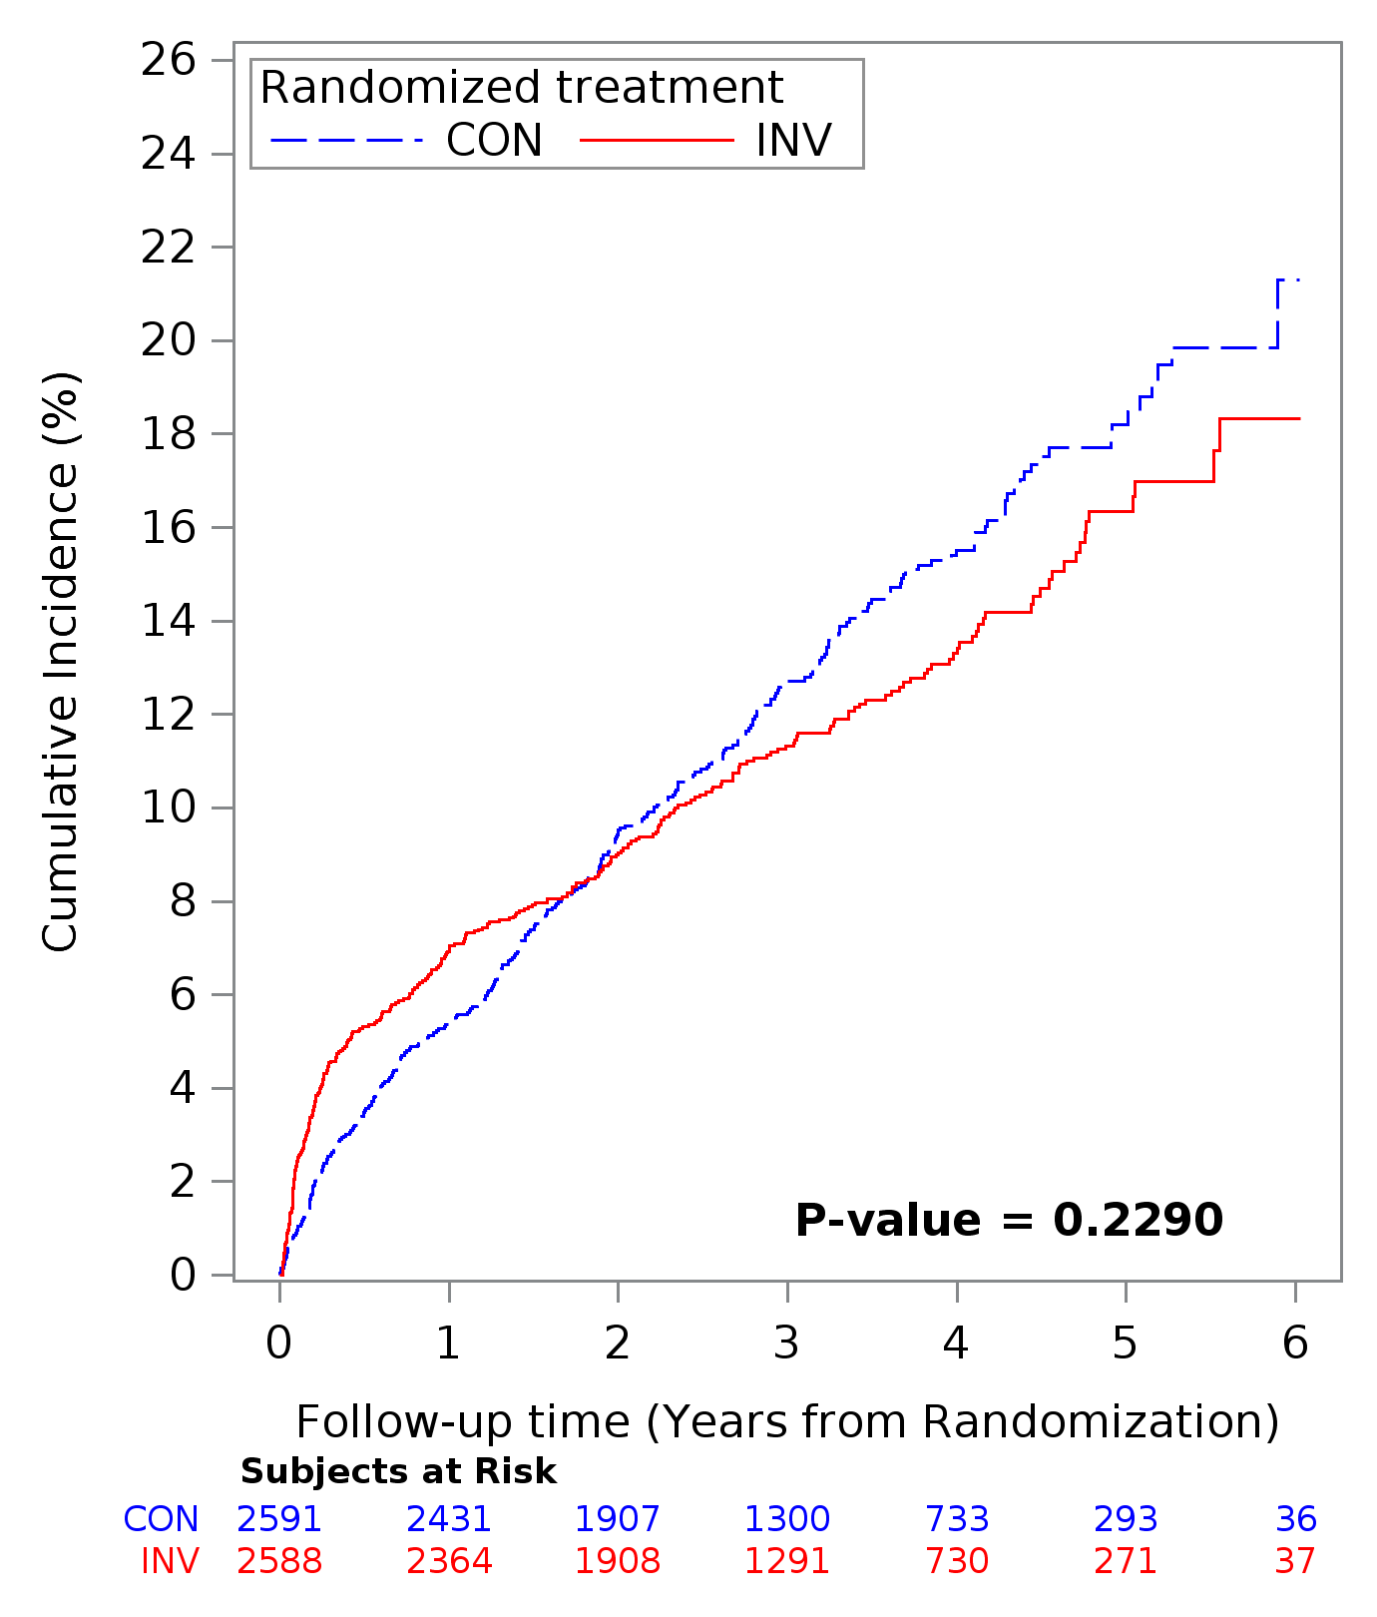
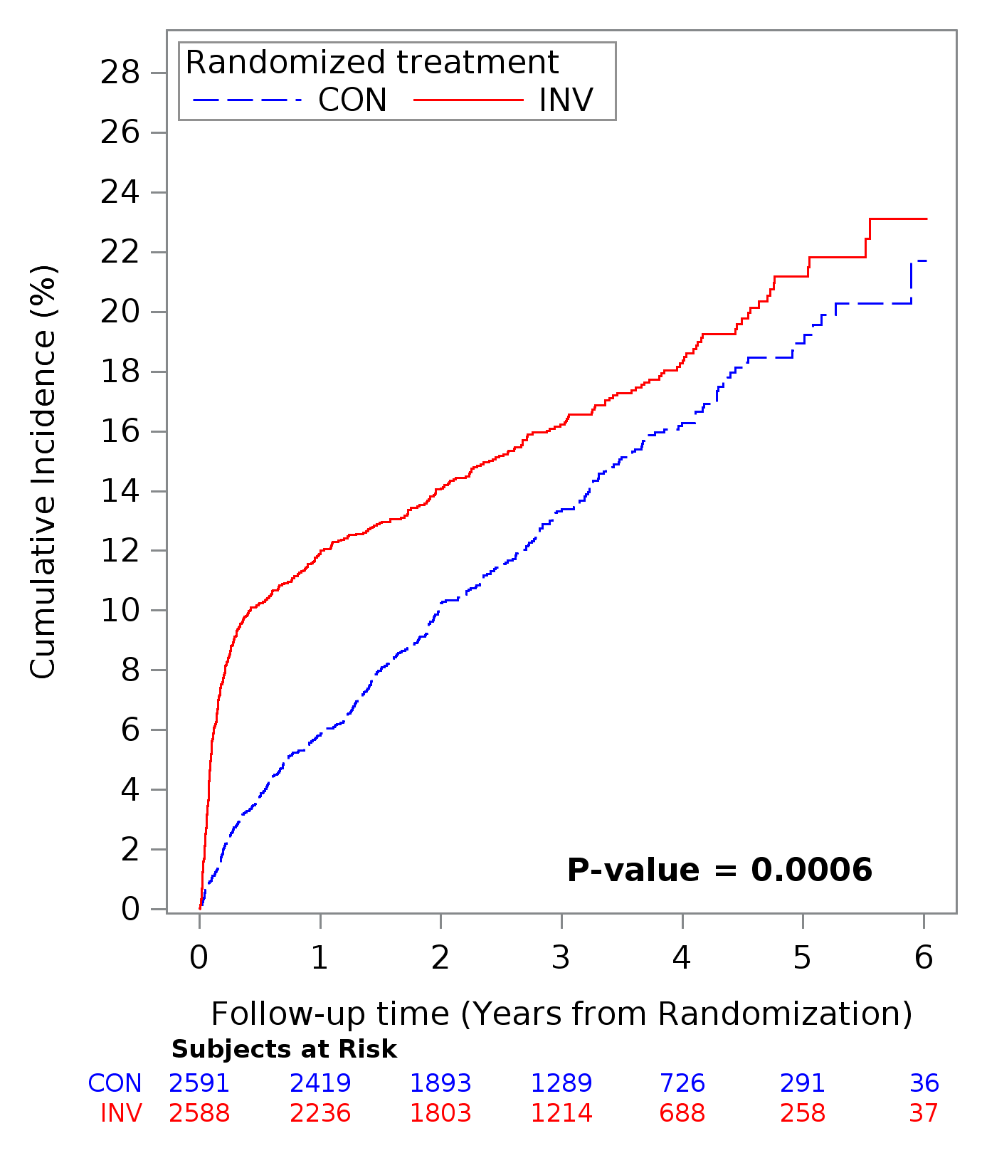
Primary Endpoint According to MI Definition
Primary Definition
Secondary Definition
Primary endpoint composite: CV Death, MI, or hospitalization for unstable angina,
heart failure, or resuscitated cardiac arrest

Slide 9
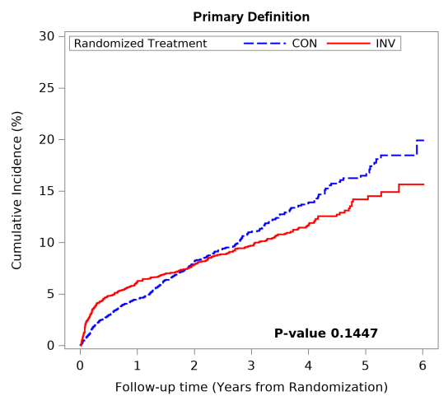
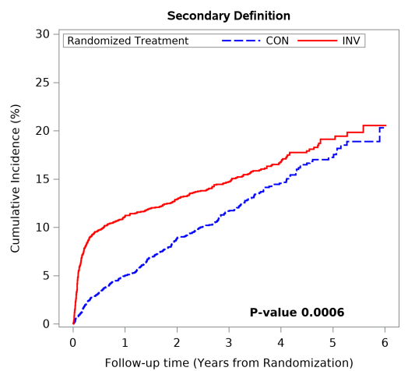
Cardiovascular Death or MI According to MI Definition
Primary Definition
Secondary Definition
Results were similar for the 5 component primary endpoint

Slide 10
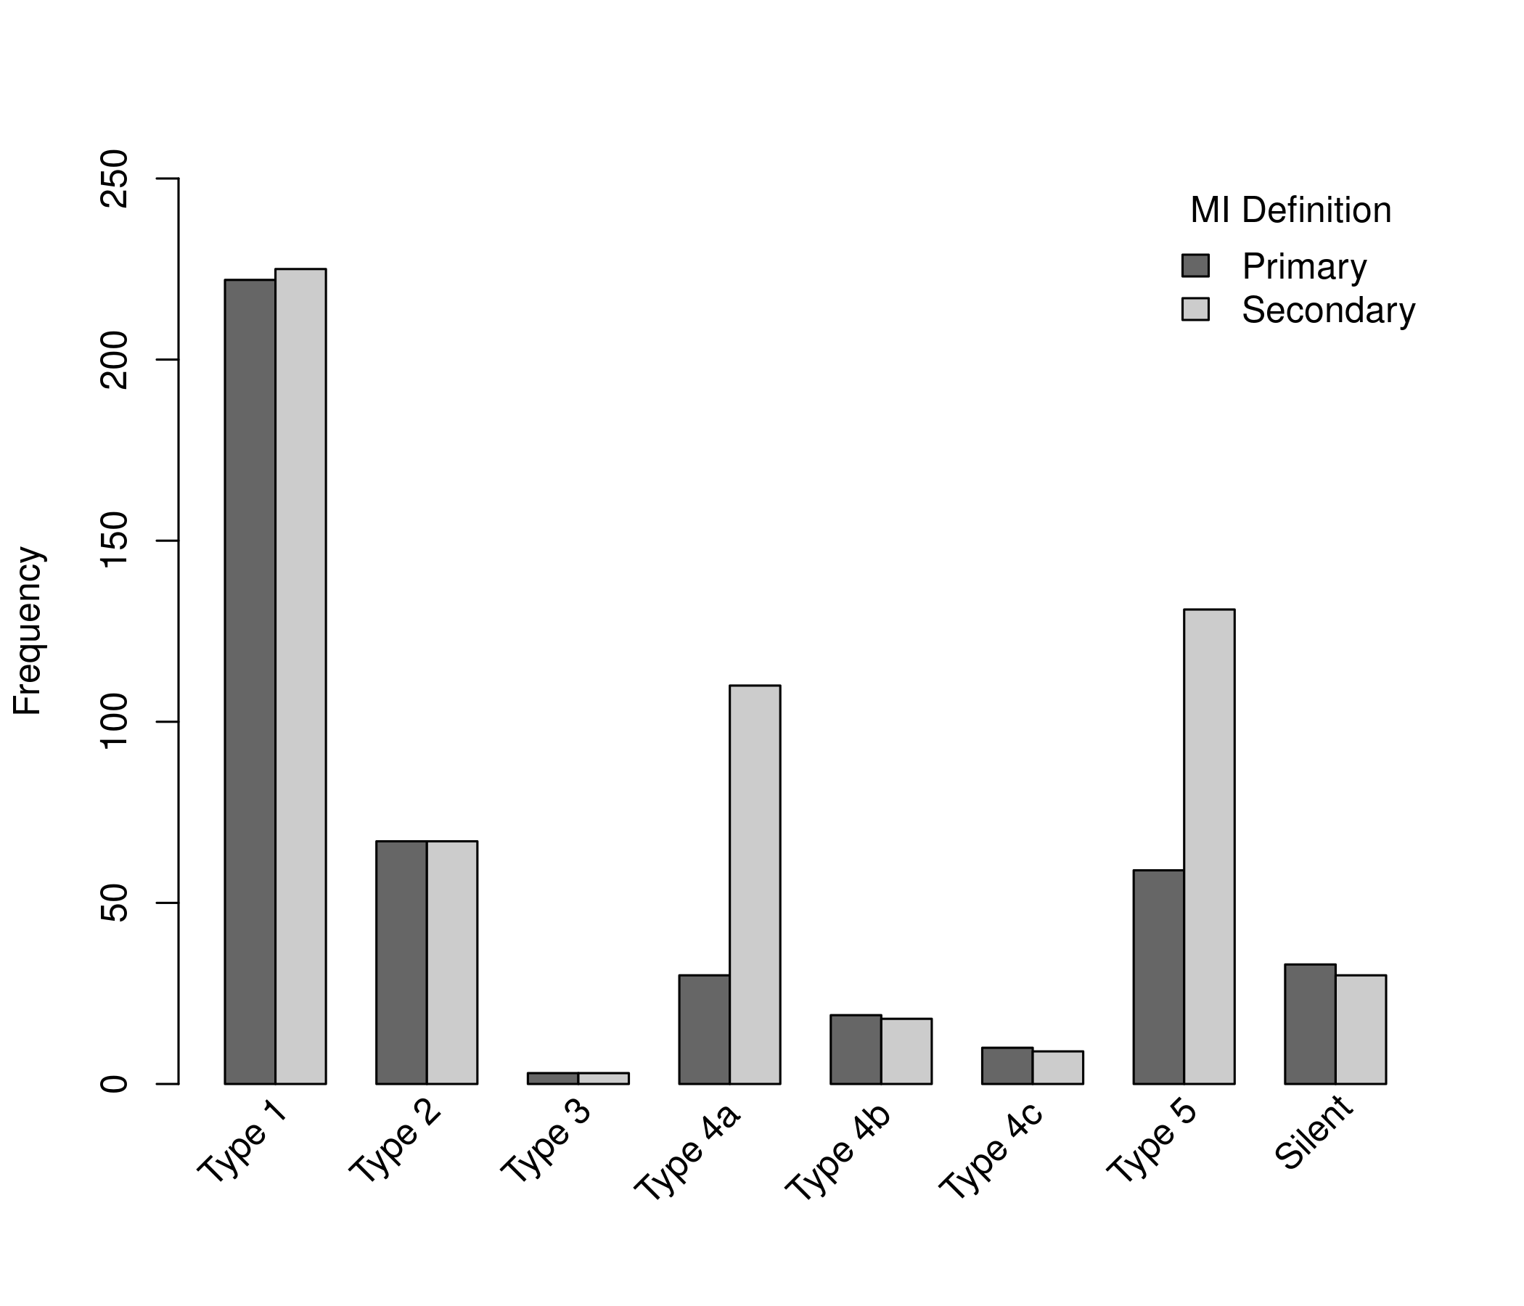
Frequency Distribution of MI Types in Ischemia by Definition
First MI events:
5,179 participants,
443 (8.6%) vs 593 (11.5%) primary vs secondary definition
Procedural MI events as % of all MI:
20.1% by primary definition vs
40.6% by secondary definition

Slide 11
MI Type by Strategy and Definition of MI
Primary Definition
Secondary Definition
Number of MI
Number of MI

Slide 12
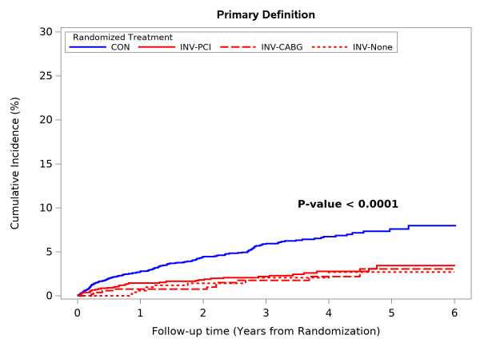
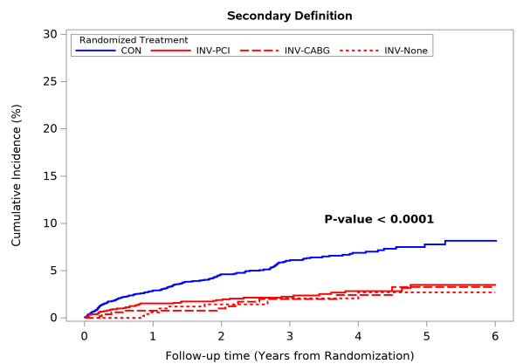
Spontaneous Type 1 MI by Strategy and by MI Definitions Management after Cath by Invasive Strategy vs Conservative Strategy
Primary Definition
Secondary Definition
Spontaneous type 1 MI were significantly reduced in the invasive strategy
Effect observed for PCI or CABG

Slide 13
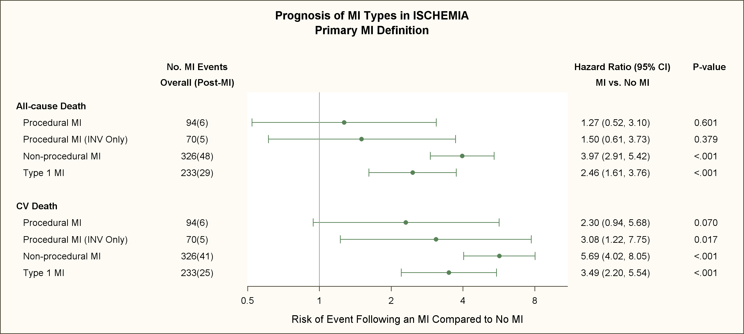
Prognosis of MI Types in ISCHEMIA
MI vs No MI; Adjusted for age, sex, eGFR, EF, diabetes, Hx HF and treatment strategy
Non-procedural MI=types 1,2, 4b and 4c

Slide 14
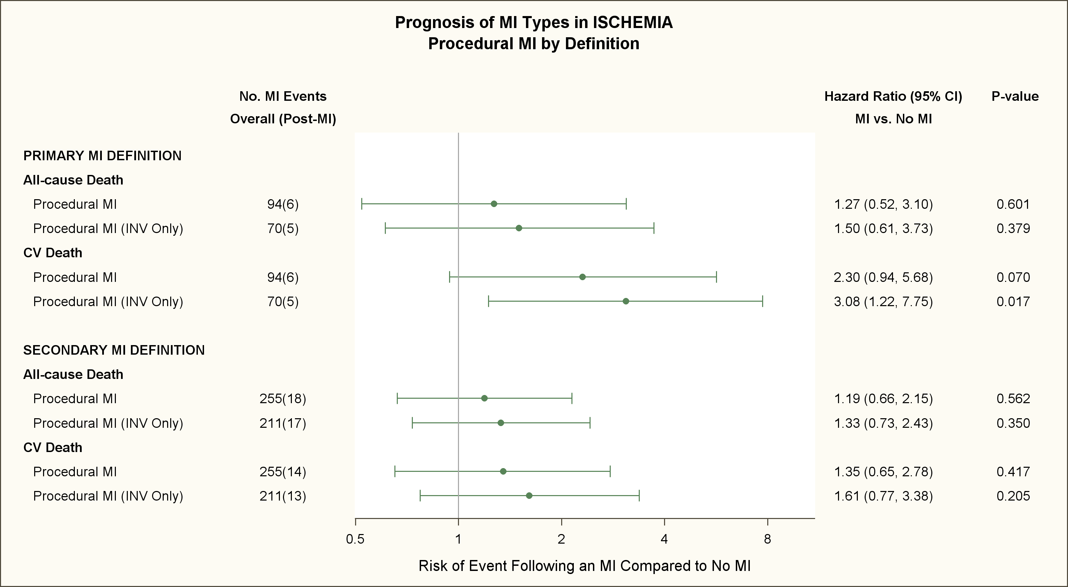
Prognosis of MI Types in ISCHEMIA
MI vs No MI; Adjusted for age, sex, eGFR, EF, diabetes, Hx HF
Non-procedural MI=types 1,2, 4b and 4c

Slide 15
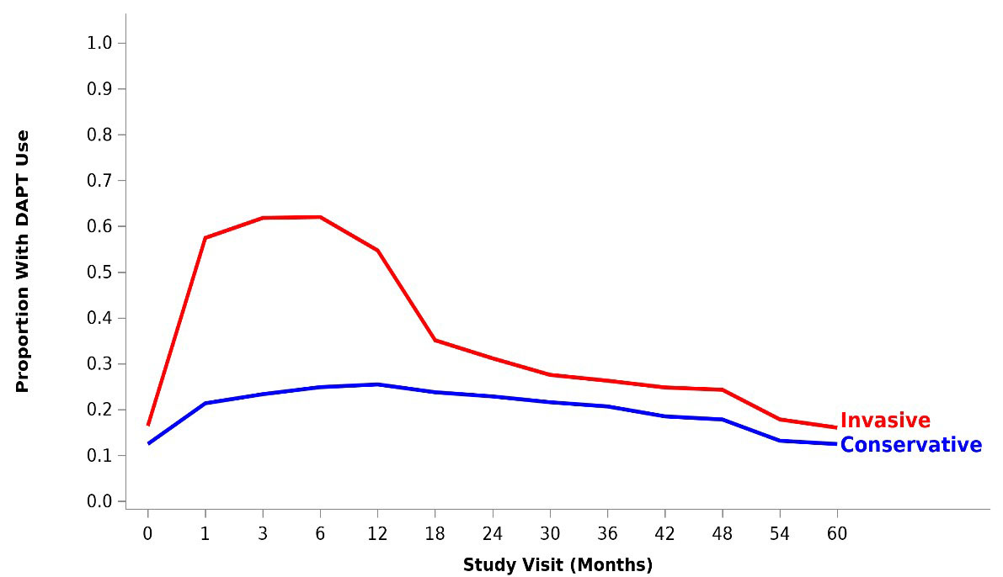
DAPT Use in the Invasive and Conservative Strategy
Maron DJ, Hochman JS et al. NEJM March 30 2020

Slide 16
Conclusions (1)
The relative risk of the primary and major secondary outcomes between treatment strategies was strongly dependent on the MI definition used
Procedural MI’s were more frequent in the invasive strategy
Spontaneous type 1 MI’s were more frequent in the conservative strategy

Slide 17
Conclusions (2)
Non-procedural and type I MI’s were strongly related to subsequent mortality
The primary definition of procedural MI was related to subsequent CV death
In contrast, the secondary definition of procedural MI was not related to subsequent CV death or all-cause death
The increased risk of subsequent death after a non-procedural or type 1 MI was greater than the increased risk after a procedural MI, regardless of MI definition used

Slide 18
Conclusions (3)
The mechanism(s) underlying the relationship for type 1 MI reduction with the invasive strategy are not clear; potential explanations include effective revascularization and/or greater use of DAPT
There was no treatment difference in all-cause mortality in the ISCHEMIA trial
Longer-term follow-up of the ISCHEMIA cohort will determine if the observed differences in MI rate and type translate into differential treatment effects on mortality

